Slide 1
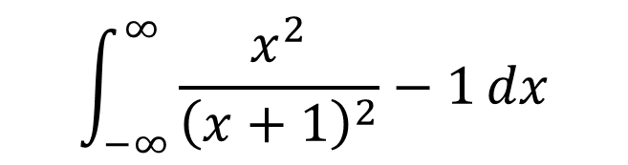
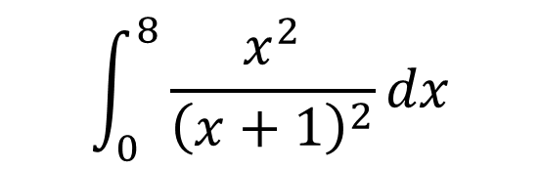
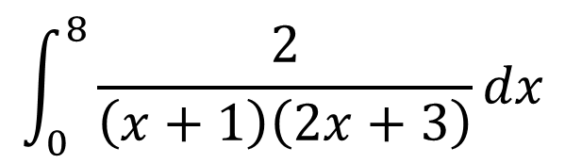
$$\int_{0}^{8}{\frac{2}{\left(x+1\right)\left(2x+3\right)}}dx$$
$$\int_{0}^{8}{\frac{x^{2}}{{\left(x+1\right)}^{2}}}dx$$
$$\int_{−∞}^{∞}{\frac{x^{2}}{{\left(x+1\right)}^{2}}−1}dx$$
This one involves topics covered in the further maths curriculum

Slide 2
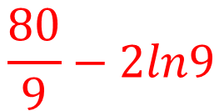
$$\int_{0}^{8}{\frac{2}{\left(x+1\right)\left(2x+3\right)}}dx$$
$$\int_{0}^{8}{\frac{x^{2}}{{\left(x+1\right)}^{2}}}dx$$
$$\int_{−∞}^{∞}{\frac{x^{2}}{{\left(x+1\right)}^{2}}−1}dx$$
$$\frac{80}{9}−2ln9$$
This one involves topics covered in the further maths curriculum

Slide 3
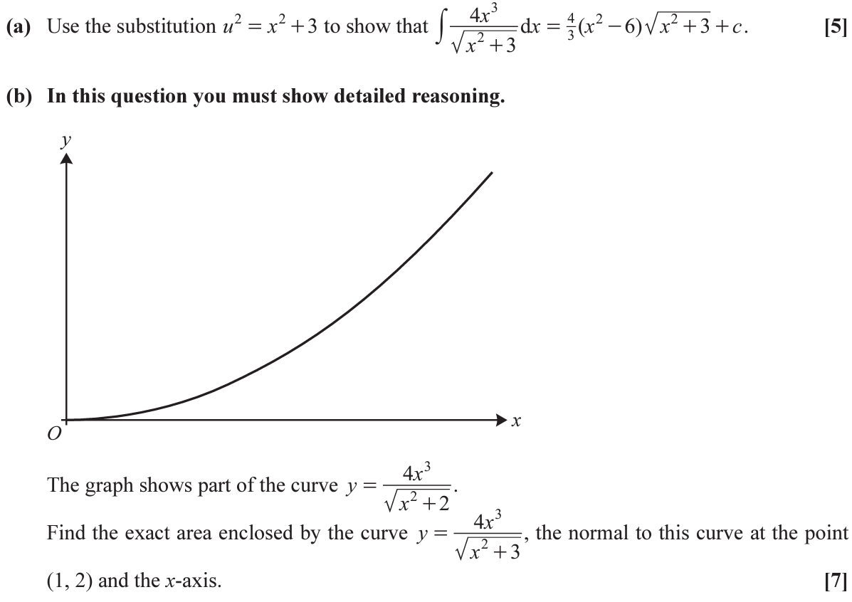
[12]

Slide 4
These should both give the same answer, but which substitution makes part (c) easier?
(c)

