Slide 1
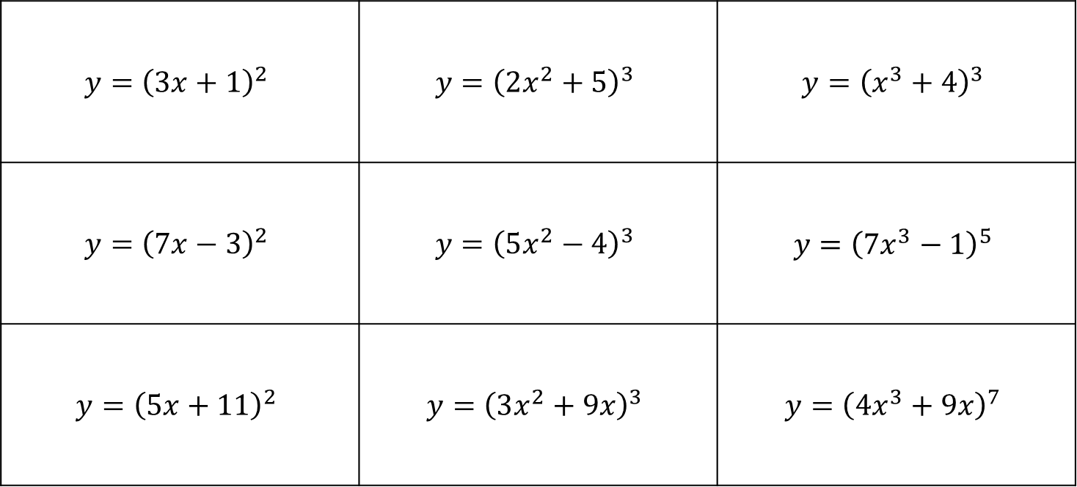
Differentiate these
Like when playing noughts and crosses, complete a whole row, column or diagonal.
$$y={\left(3x+1\right)}^{2}$$ | $$y={\left(2x^{2}+5\right)}^{3}$$ | $$y={\left(x^{3}+4\right)}^{3}$$
$$y={\left(7x−3\right)}^{2}$$ | $$y={\left(5x^{2}−4\right)}^{3}$$ | $$y={\left({7x}^{3}−1\right)}^{5}$$
$$y={\left(5x+11\right)}^{2}$$ | $$y={\left(3x^{2}+9x\right)}^{3}$$ | $$y={\left({4x}^{3}+9x\right)}^{7}$$
Deduce an easier method (other than brute force expanding, differentiating and factorising) for differentiating these equations.

Slide 2
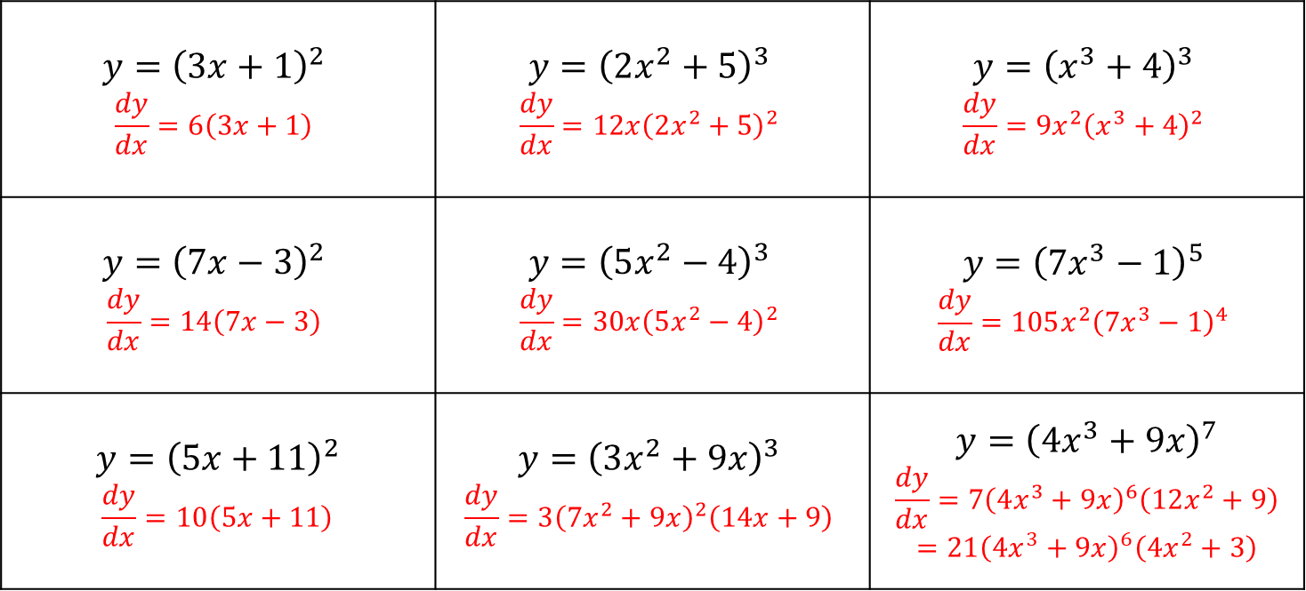
Differentiate these - answers
Like when playing noughts and crosses, complete a whole row, column or diagonal.
$$y={\left(3x+1\right)}^{2}$$ $$\frac{dy}{dx}=6\left(3x+1\right)$$ | $$y={\left(2x^{2}+5\right)}^{3}$$ $$\frac{dy}{dx}=12x{\left(2x^{2}+5\right)}^{2}$$ | $$y={\left(x^{3}+4\right)}^{3}$$ $$\frac{dy}{dx}=9x^{2}{\left(x^{3}+4\right)}^{2}$$
$$y={\left(7x−3\right)}^{2}$$ $$\frac{dy}{dx}=14\left(7x−3\right)$$ | $$y={\left(5x^{2}−4\right)}^{3}$$ $$\frac{dy}{dx}=30x{\left(5x^{2}−4\right)}^{2}$$ | $$y={\left({7x}^{3}−1\right)}^{5}$$ $$\frac{dy}{dx}=105x^{2}{\left(7x^{3}−1\right)}^{4}$$
$$y={\left(5x+11\right)}^{2}$$ $$\frac{dy}{dx}=10\left(5x+11\right)$$ | $$y={\left(3x^{2}+9x\right)}^{3}$$ $$\frac{dy}{dx}=3{\left(7x^{2}+9x\right)}^{2}\left(14x+9\right)$$ | $$y={\left({4x}^{3}+9x\right)}^{7}$$ $$\frac{dy}{dx}=7{\left(4x^{3}+9x\right)}^{6}\left(12x^{2}+9\right)$$ $$=21{\left(4x^{3}+9x\right)}^{6}\left(4x^{2}+3\right)$$
Deduce an easier method (other than brute force expanding, differentiating and factorising) for differentiating these equations.

Slide 3
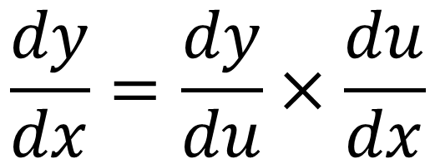
The Chain Rule, or function of a function.
$$\frac{dy}{dx}=\frac{dy}{du}×\frac{du}{dx}$$

