Slide 1
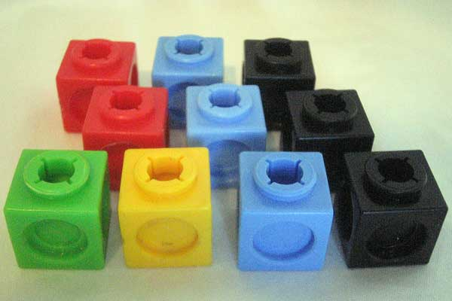
What Are We Looking At?
For this activity you will need 10 cubes of the colours shown here.
You will see 2 images of each arrangement of the 10 cubes.
There are 8 arrangements.
Your task is to recreate each arrangement to fit the images that you see.

Slide 2
Arrangement 1
Left Hand Side View
Front View

Slide 3
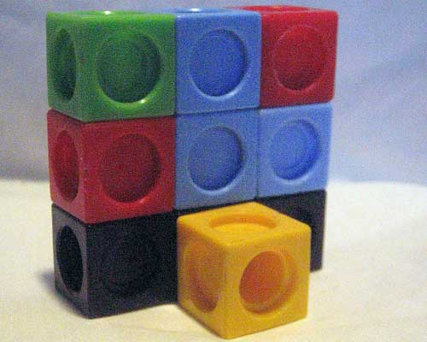
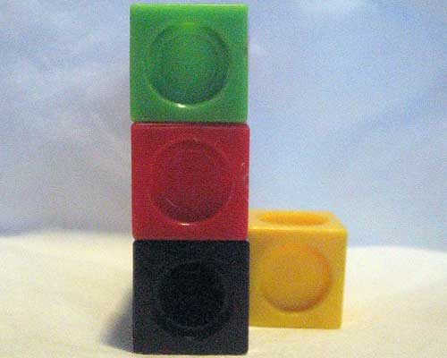
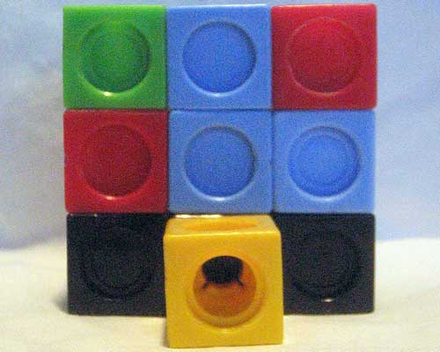
Arrangement 1

Slide 6
Arrangement 2
Left Hand Side View
Front View

Slide 7
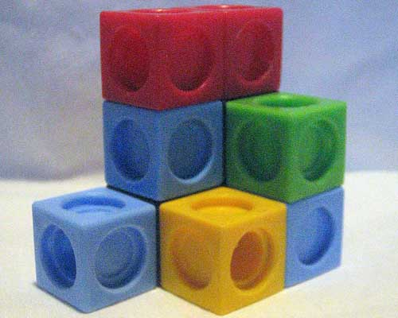
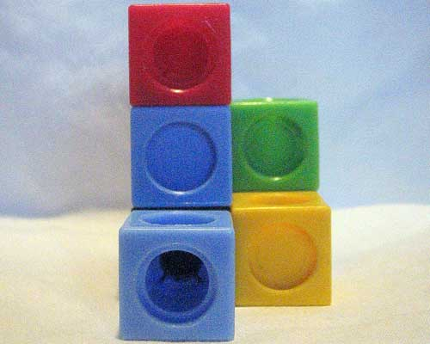
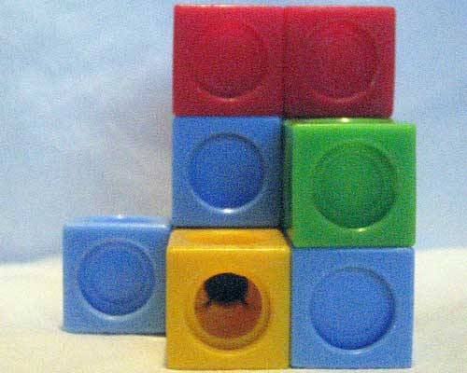
Arrangement 2

Slide 10
Arrangement 3
Left Hand Side View
Front View

Slide 11
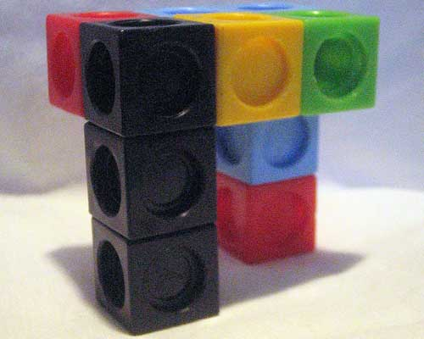
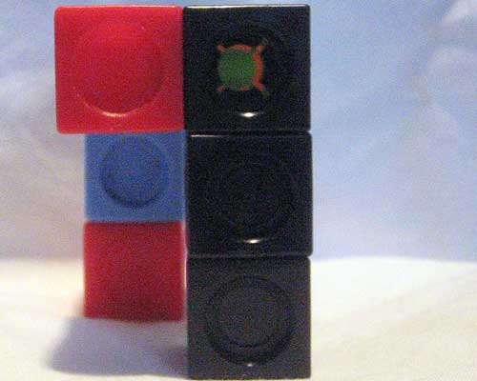
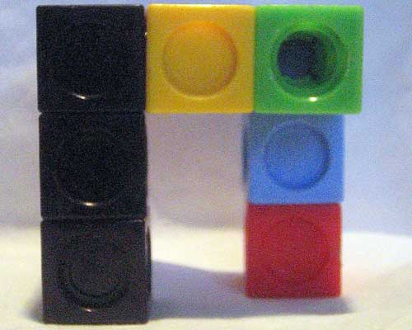
Arrangement 3

Slide 14
Arrangement 4
Left Hand Side View
Front View

Slide 15
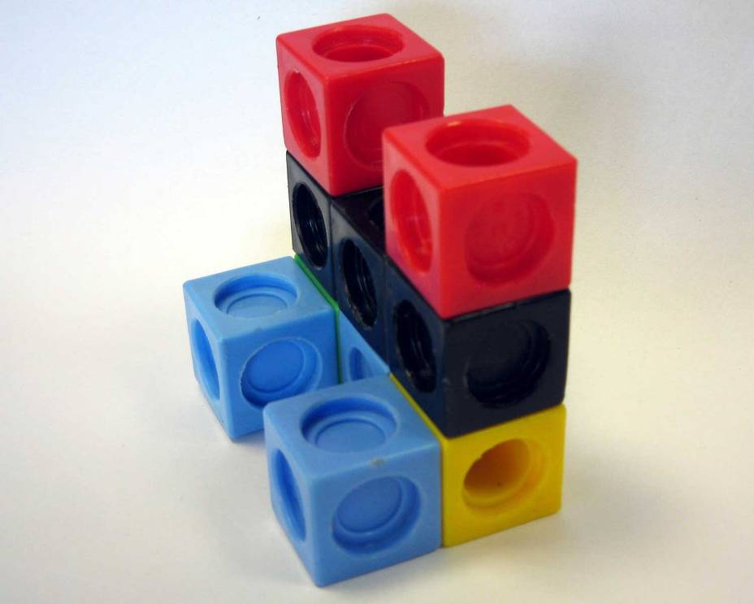
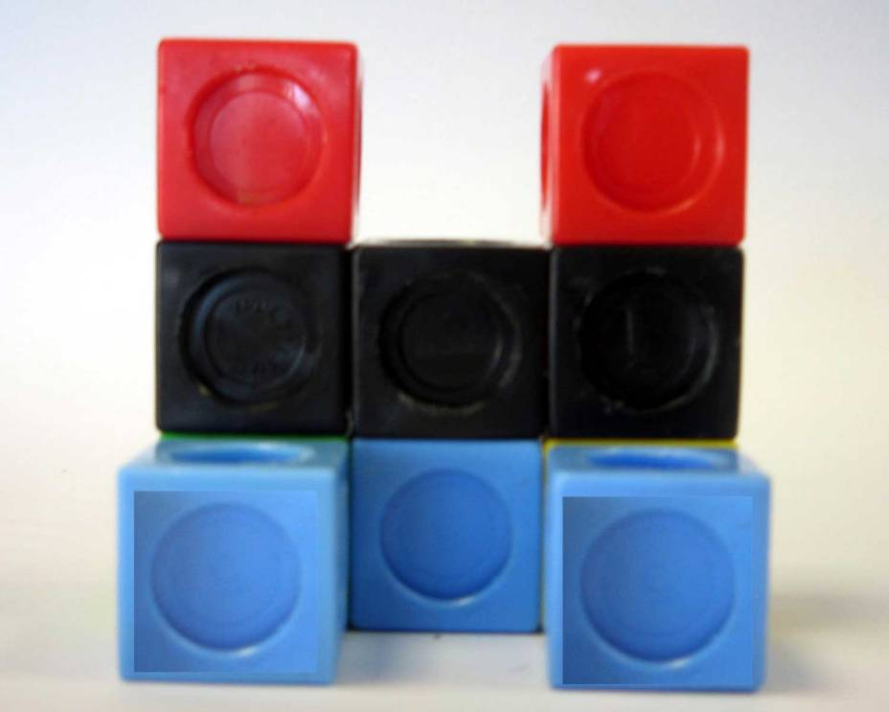
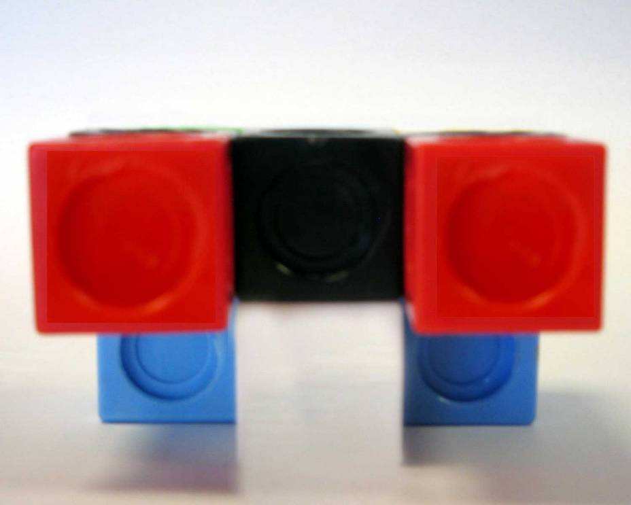
Arrangement 4

Slide 18
Arrangement 5
Left Hand Side View
Front View

Slide 19
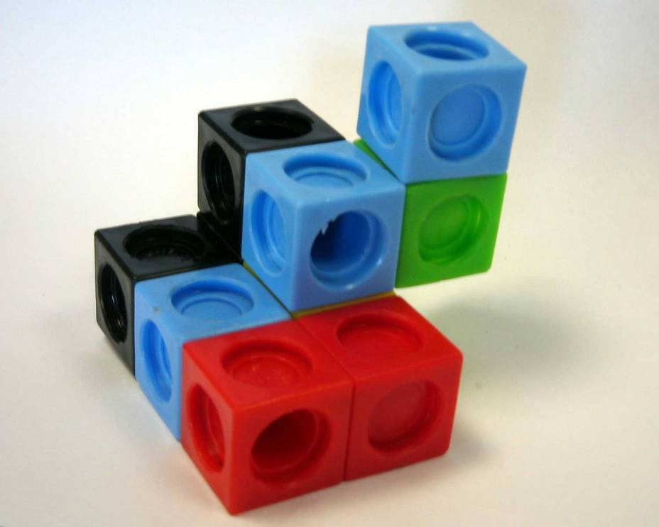
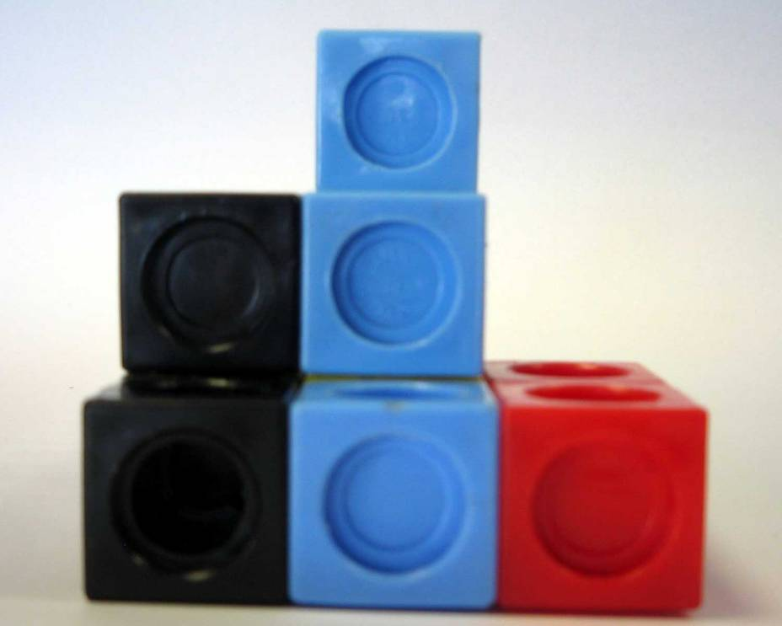
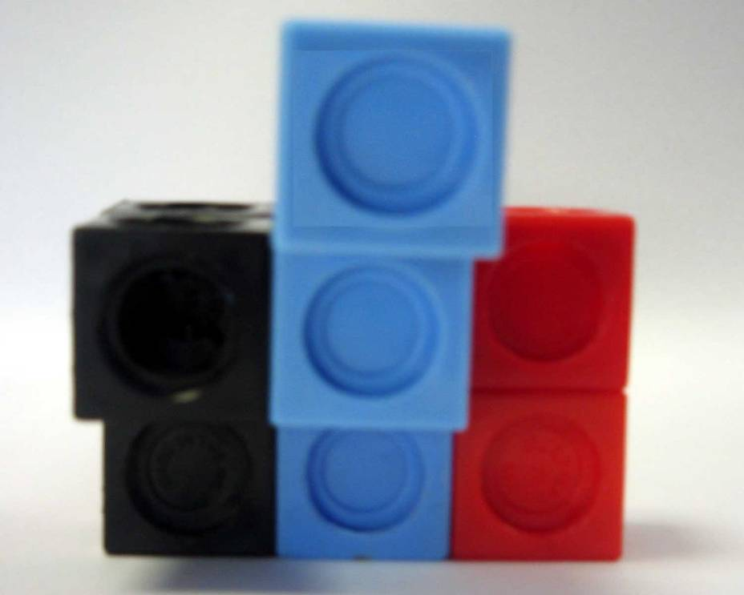
Arrangement 5

Slide 22
Arrangement 6
Left Hand Side View
Front View

Slide 23
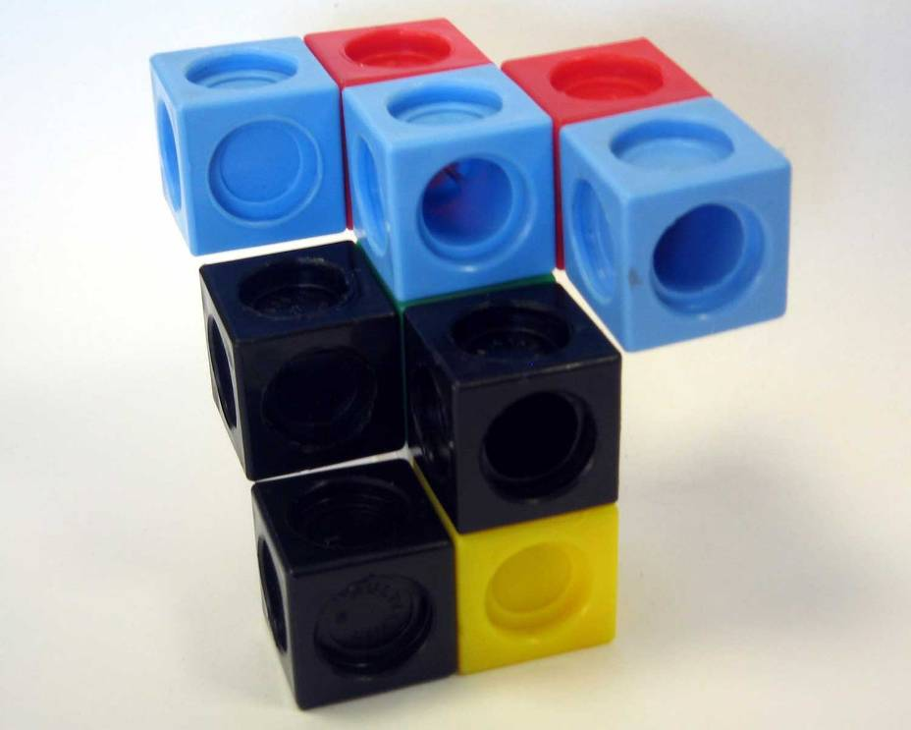
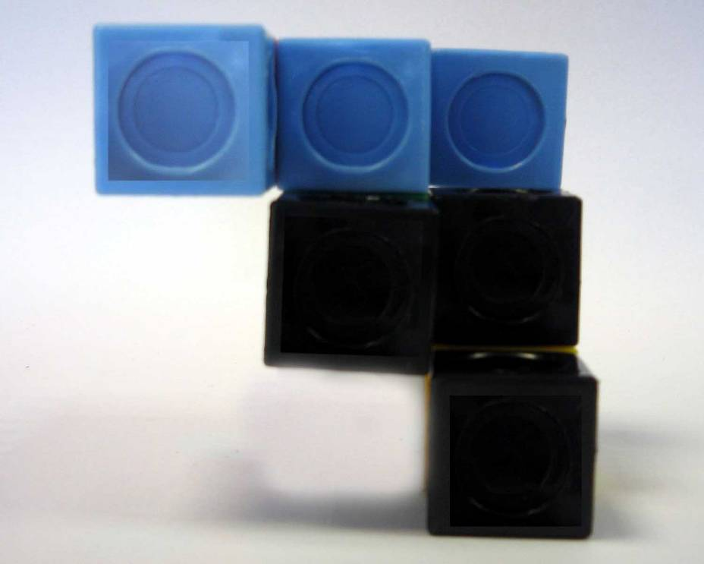
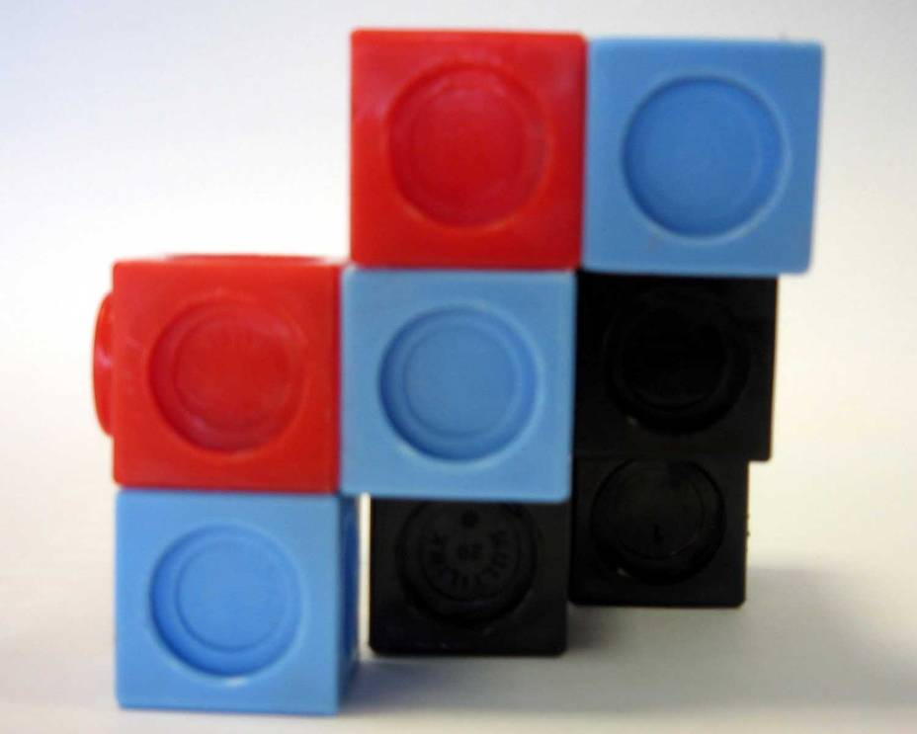
Arrangement 6

Slide 26
Arrangement 7
Left Hand Side View
Front View

Slide 27
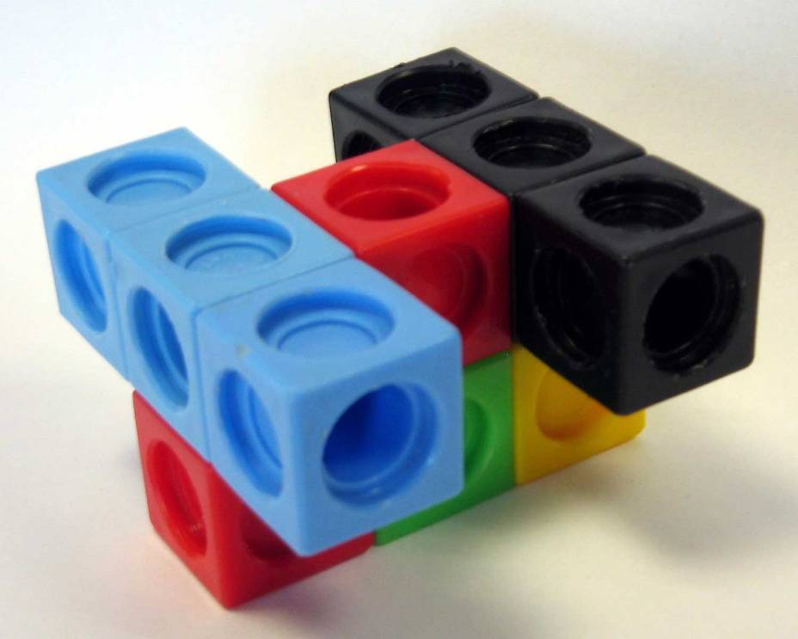
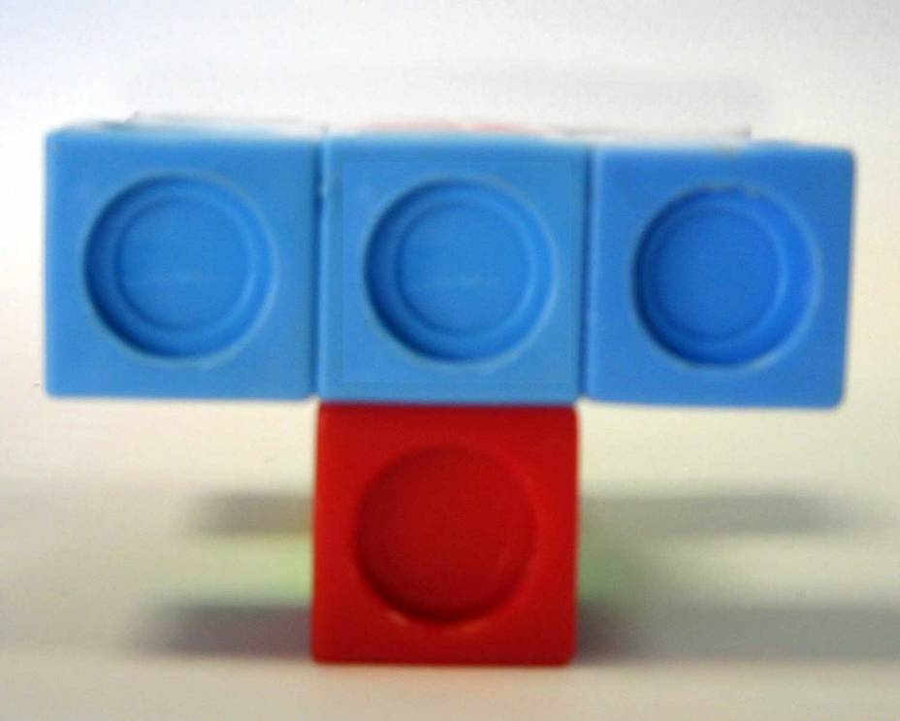
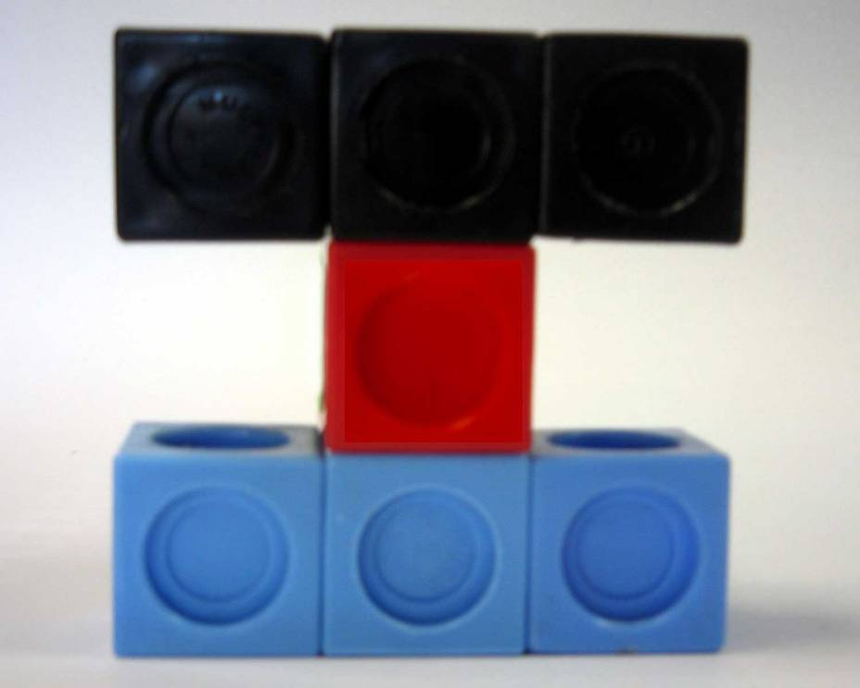
Arrangement 7

Slide 30
Arrangement 8
Left Hand Side View
Front View

Slide 31
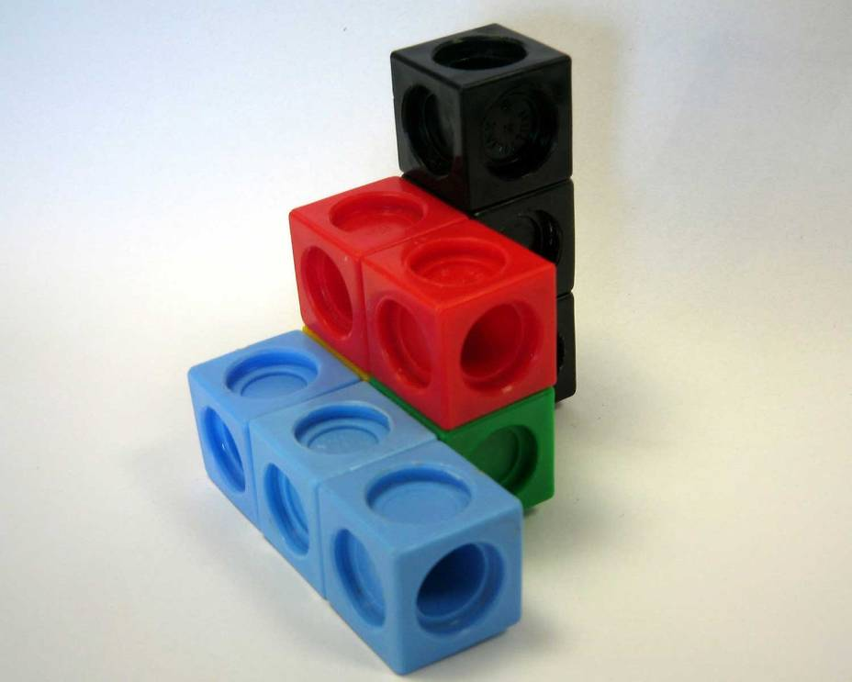
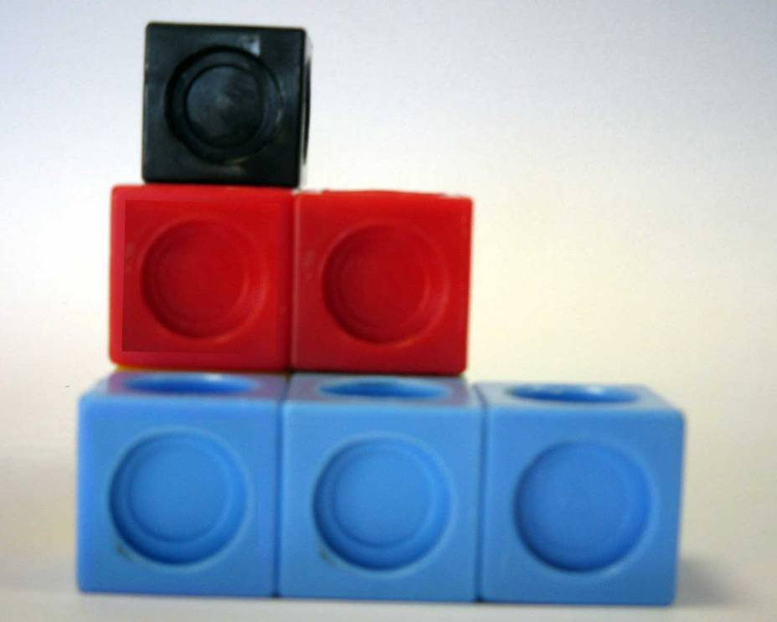
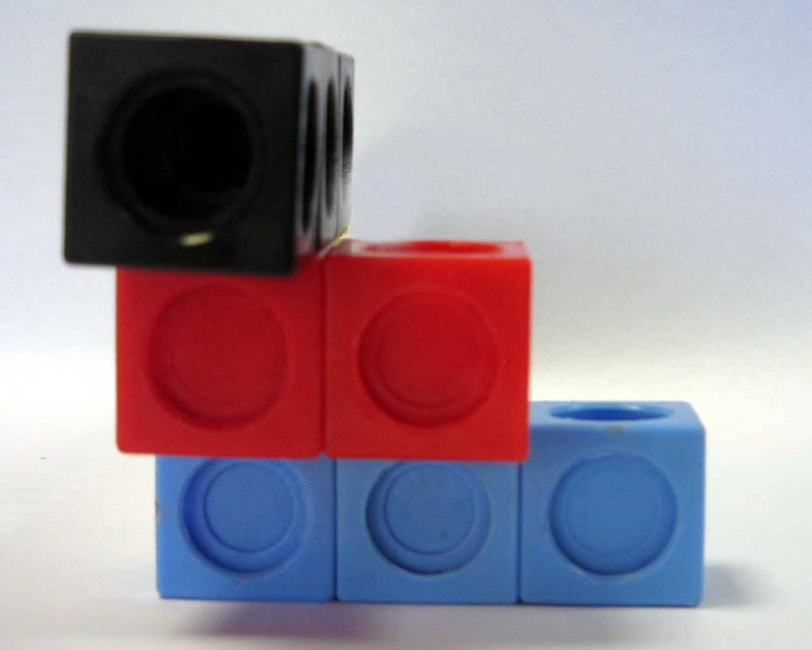
Arrangement 8

Slide 34
Arrangement 9
Left Hand Side View
Front View

Slide 35
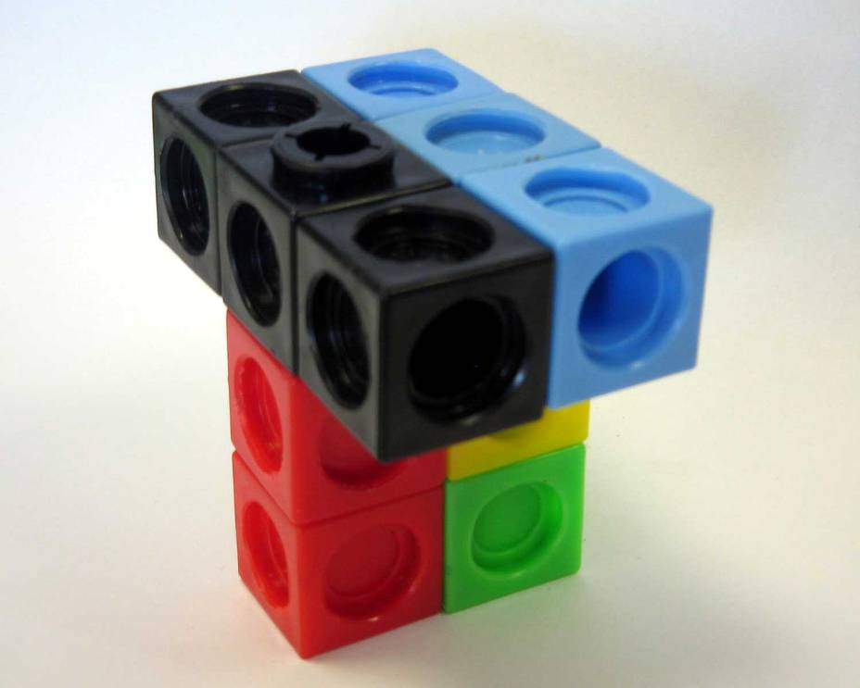
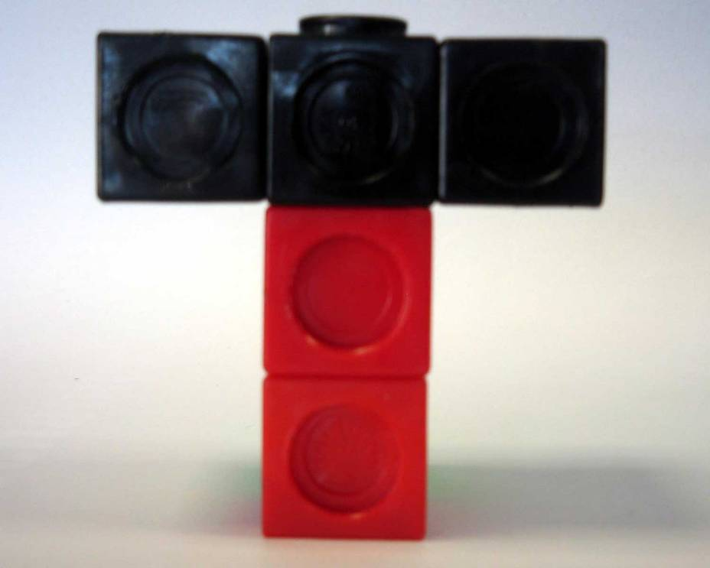
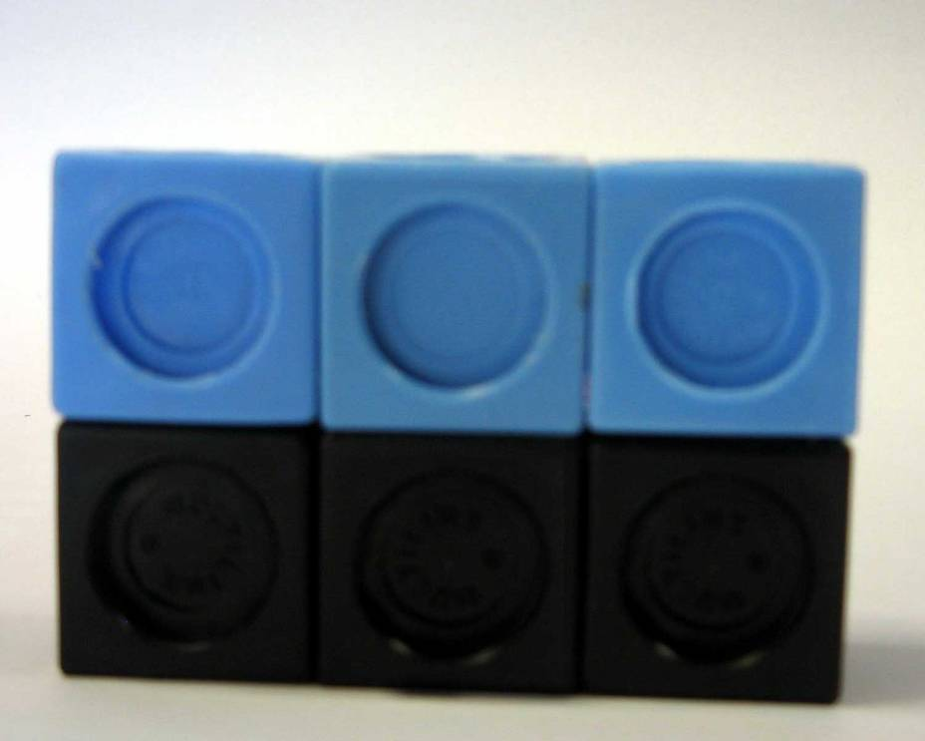
Arrangement 9

Slide 38
Arrangement 10
Left Hand Side View
Front View

Slide 39
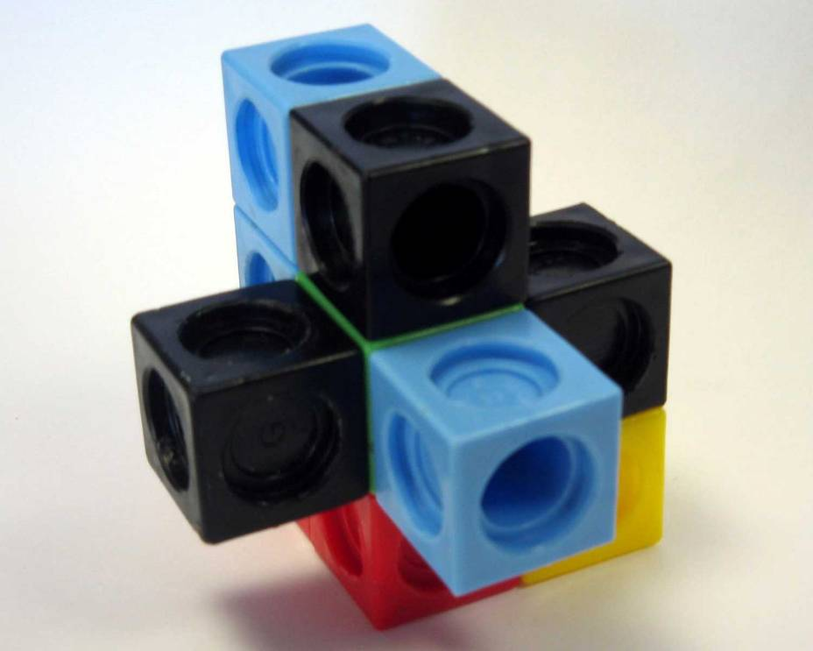
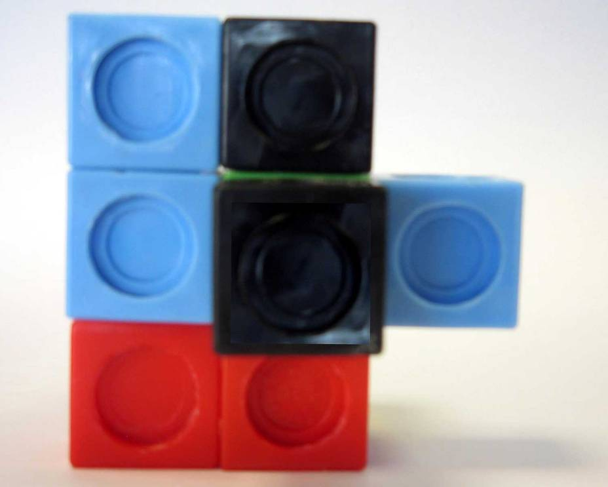
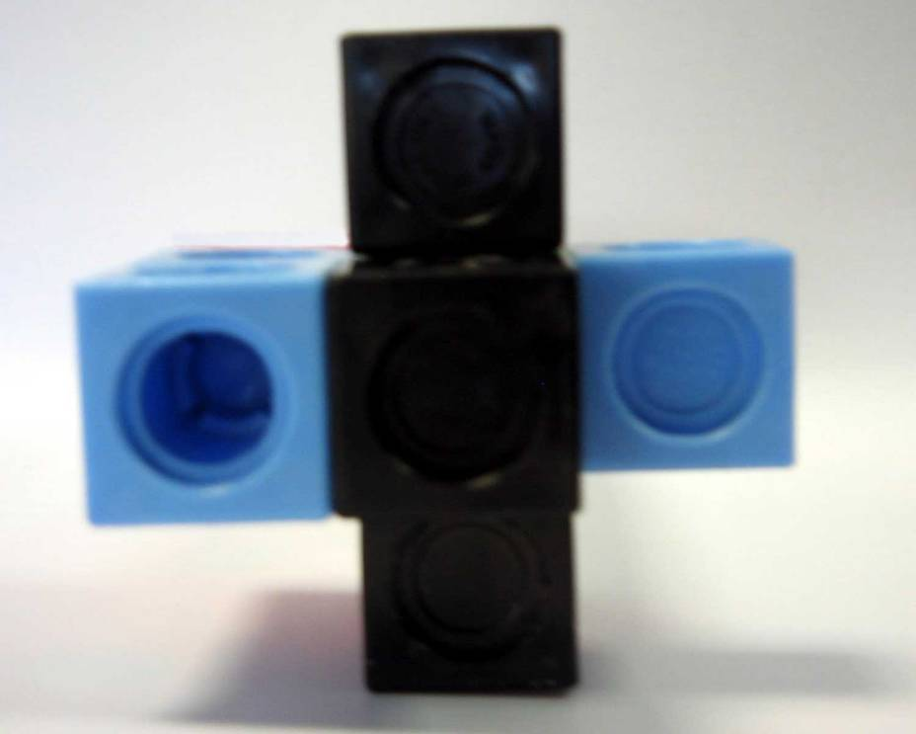
Arrangement 10

Slide 42
Arrangement 11
Left Hand Side View
Front View

Slide 43
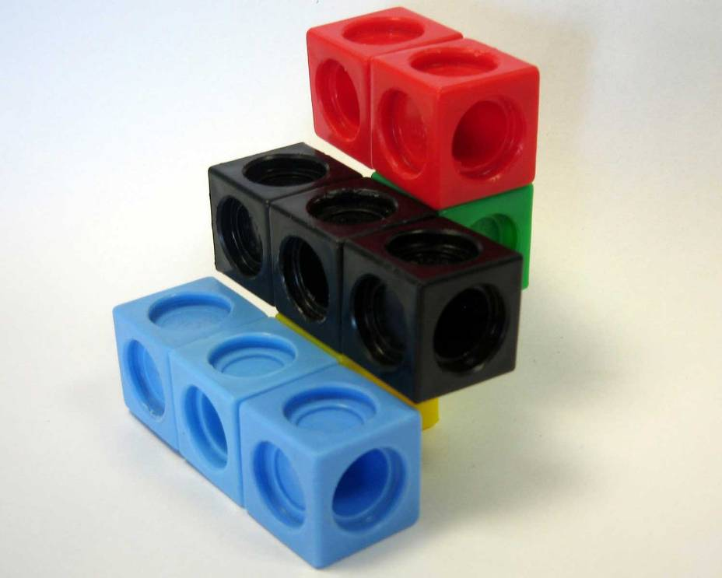
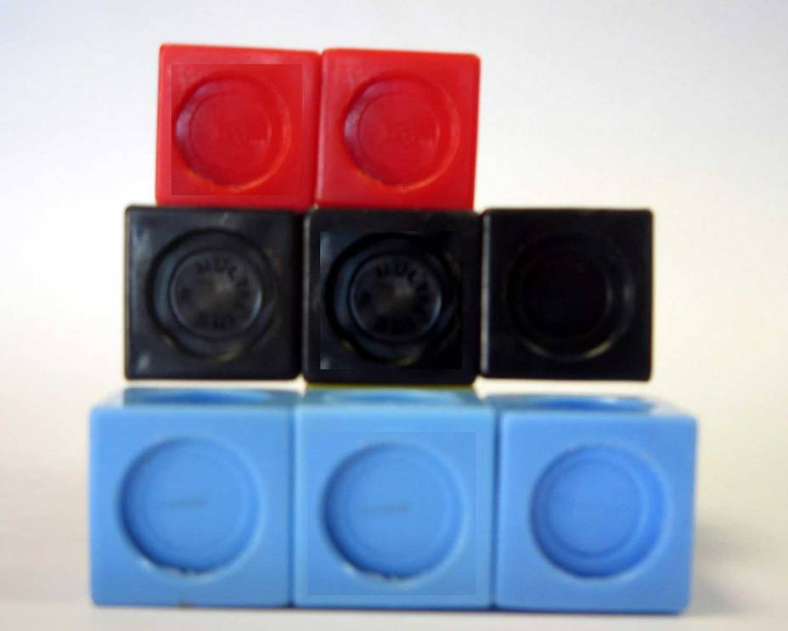
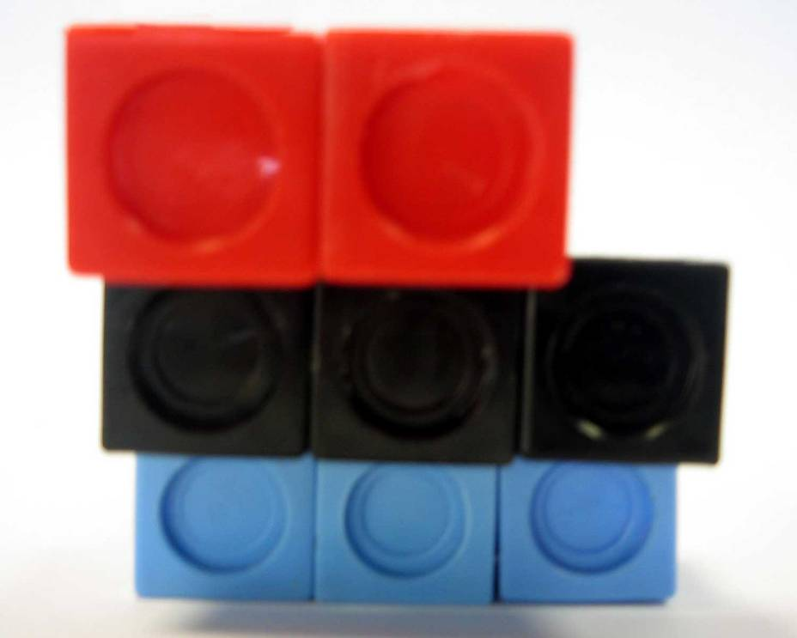
Arrangement 11

Slide 46
Arrangement 12
Left Hand Side View
Front View

Slide 47
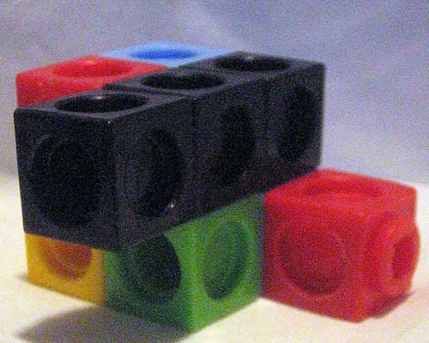
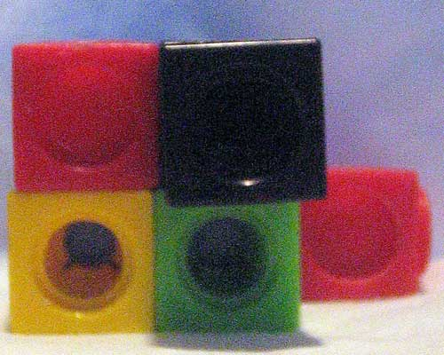
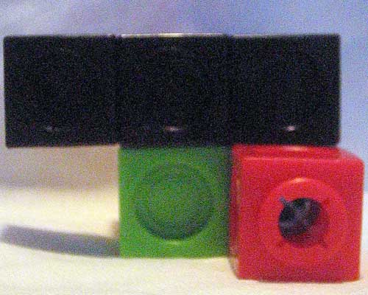
Arrangement 12

Slide 50
Arrangement 13
Left Hand Side View
Front View

Slide 51
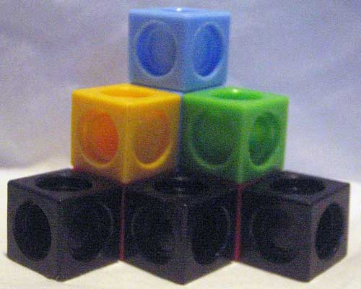
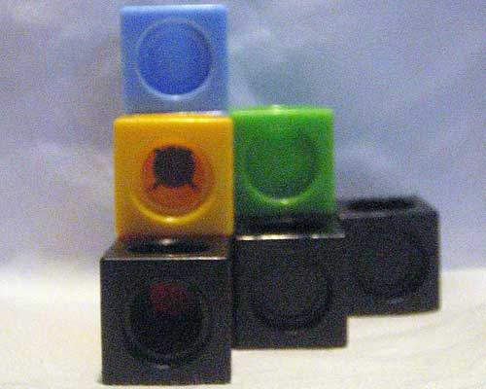
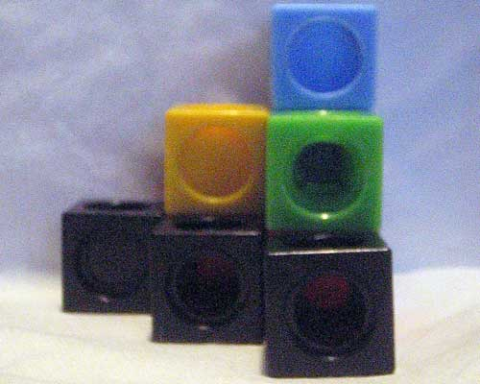
Arrangement 13

Slide 54
Arrangement 14
Left Hand Side View
Front View

Slide 55
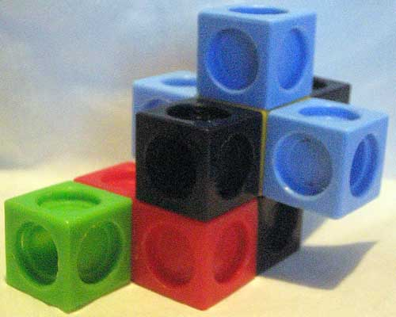
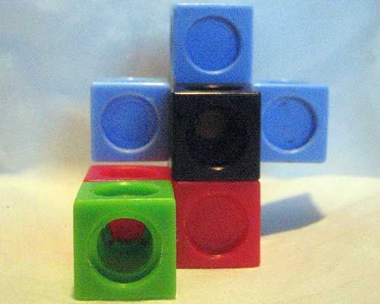
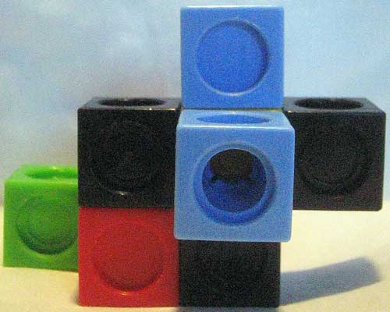
Arrangement 14

Slide 58
TEMPLATE
Left Hand Side View
Front View

