Slide 1
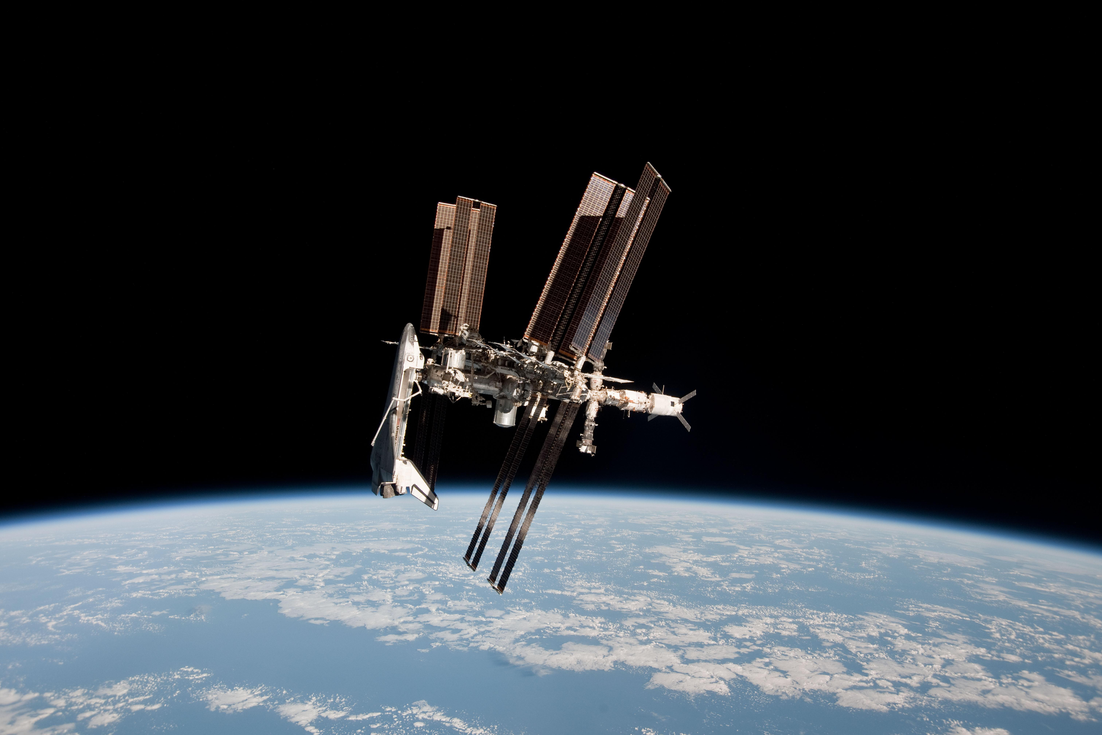

Slide 2
International Space Station
The International Space Station orbits at an altitude of 250miles
It travels at a speed of 17,500mph
It completes 1 orbit every 90minutes
Find the circumference of the Earth

Slide 3
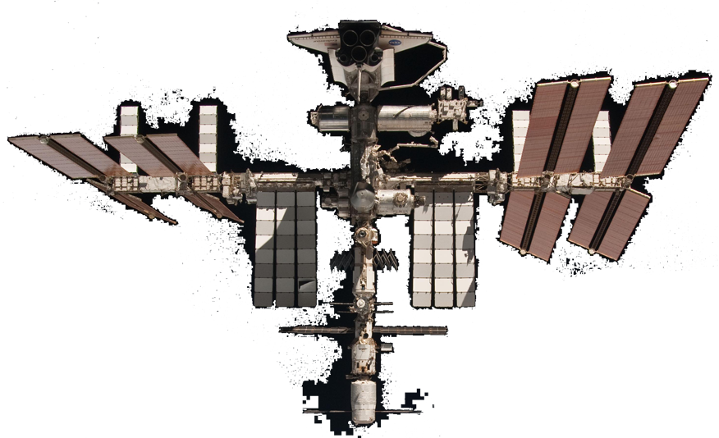
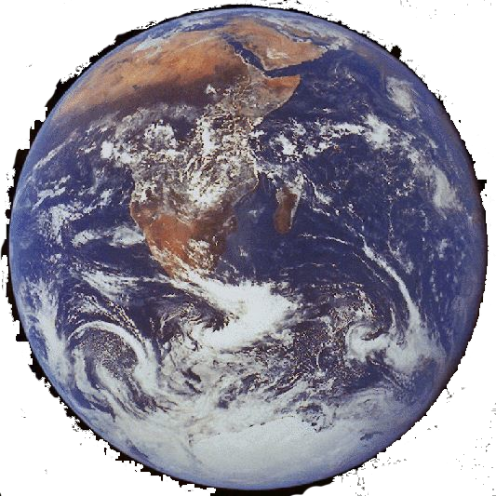
17,500mph
Height 250miles
What is the circumference of the Earth?
1 orbit every 90minutes

