Slide 1
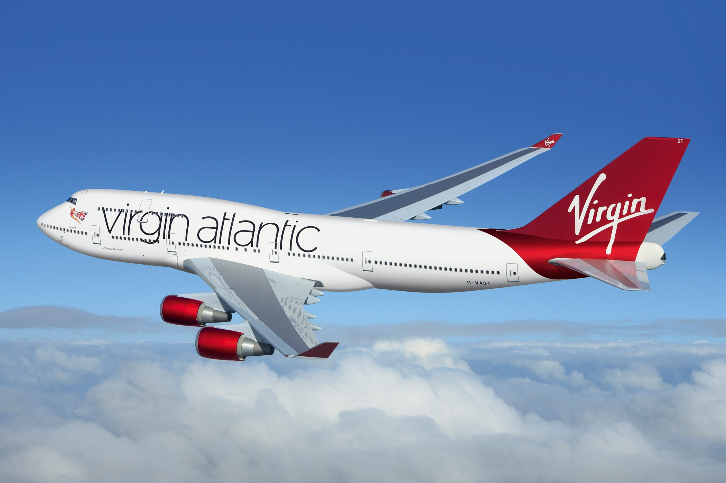
Transatlantic Jet

Slide 2
This is the largest and most expensive spacecraft ever. It is the size of a football pitch and has been permanently manned since 2000. It was created by space agencies from Canada, USA, Japan, Russia and Europe all working together.
The main purpose of the spacecraft is to conduct scientific experiments in zero-gravity but fulfils many other roles in addition to this.
What might some of these roles be?
250 miles ≈ 400 km
Tennis ball scale = 0.9 cm

Slide 3
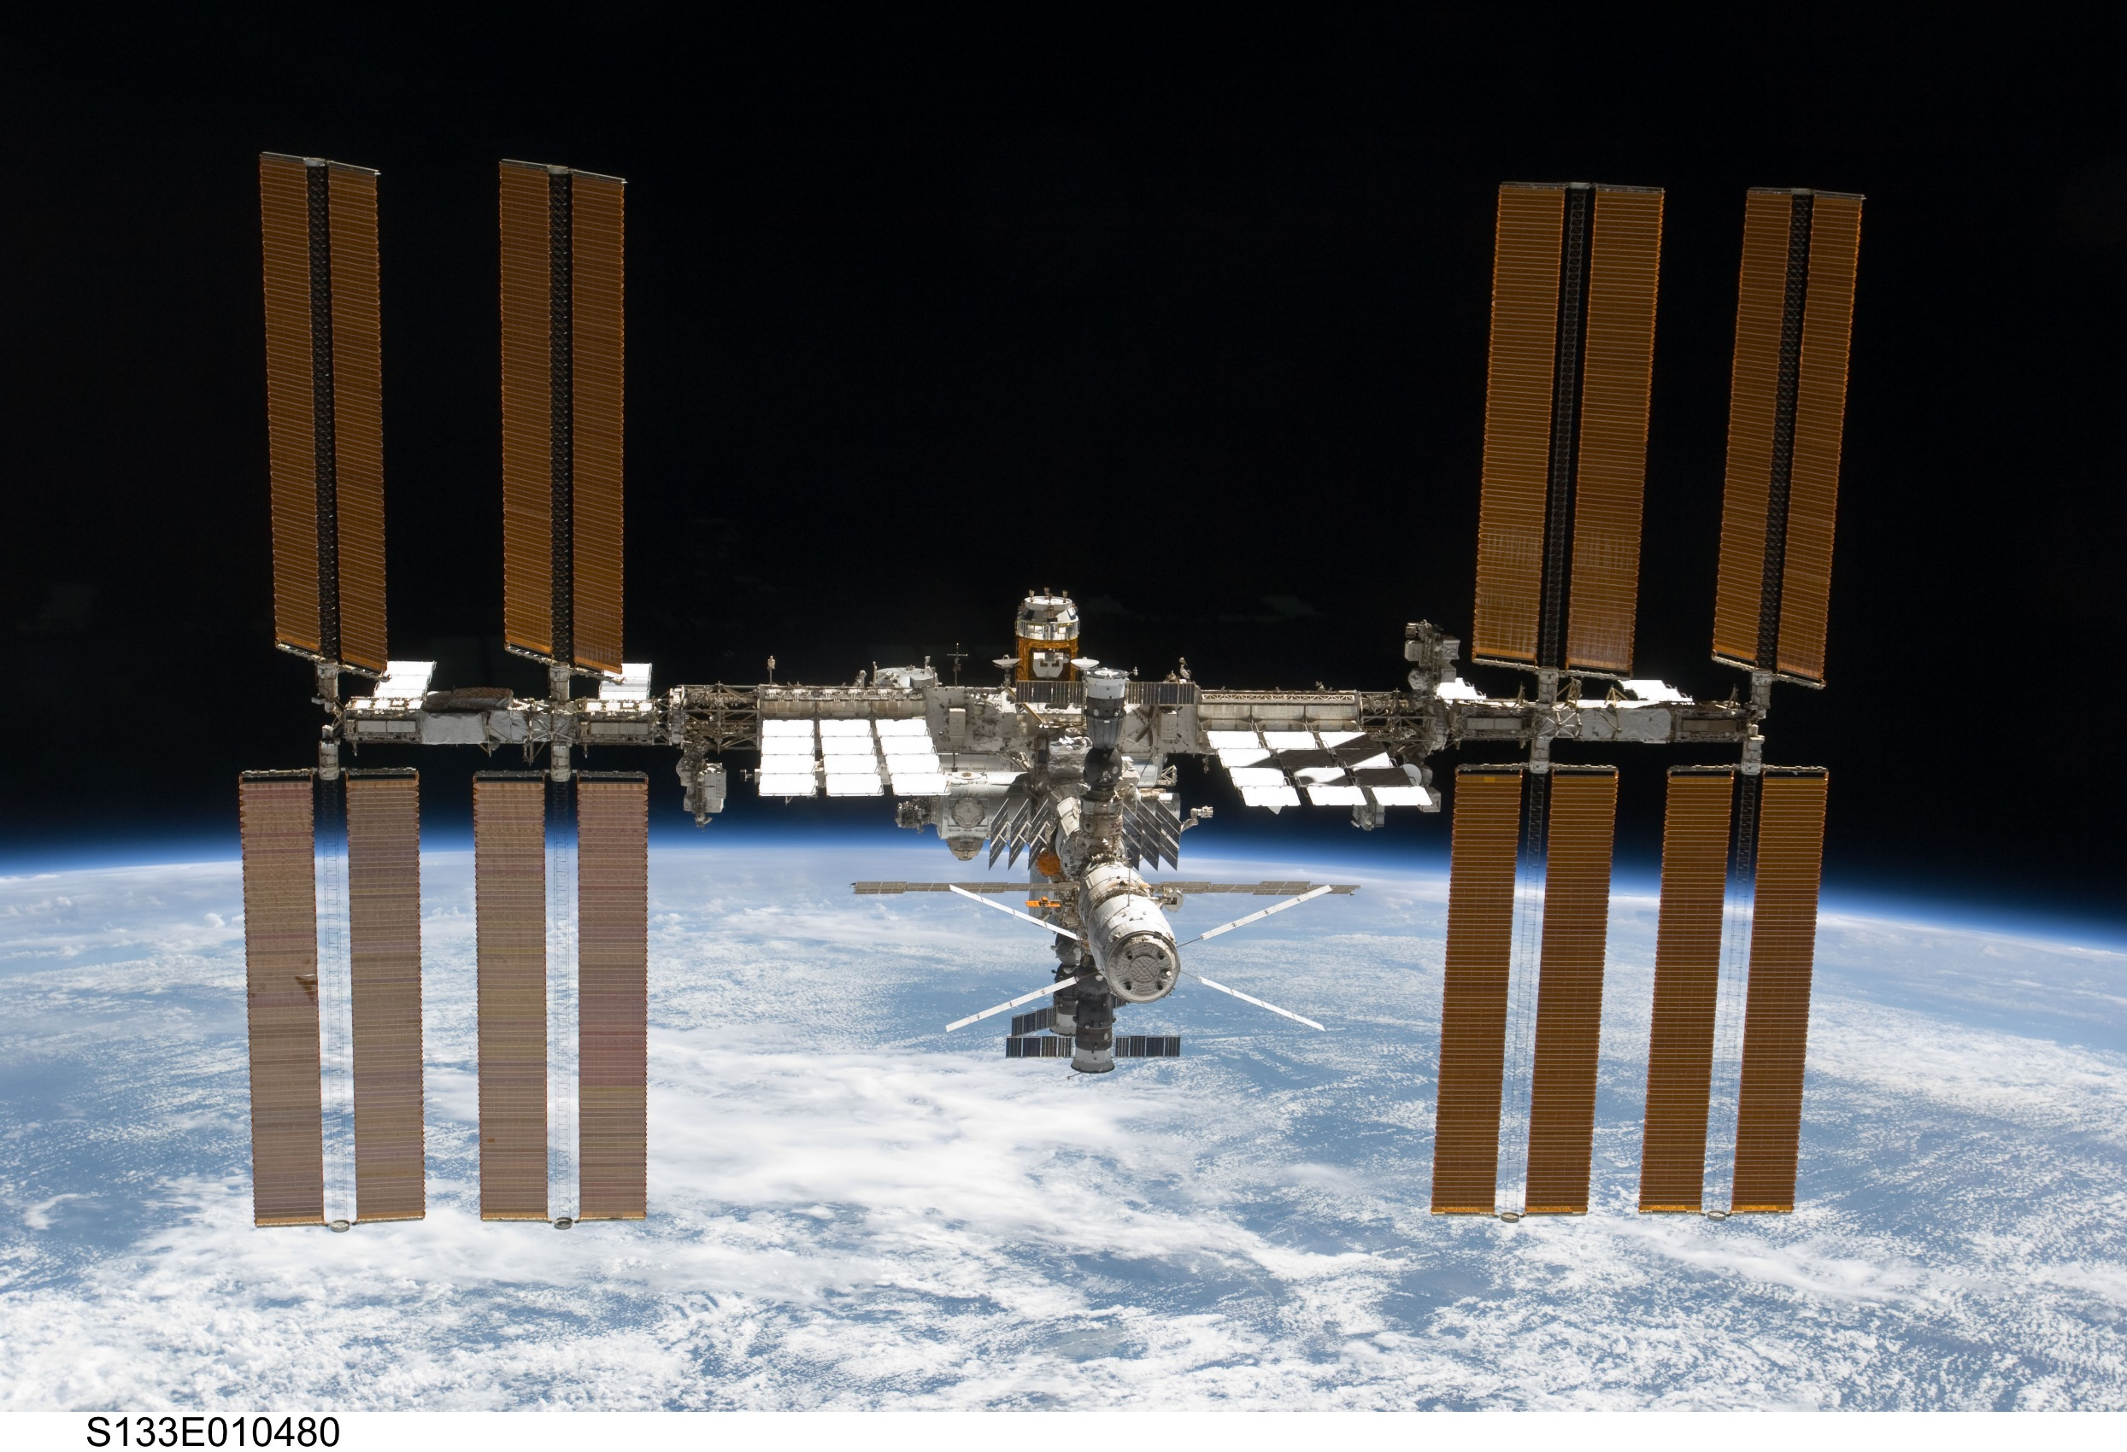
International Space Station

Slide 4
Launched by the USSR in 1957, this was the first ever man-made satellite to orbit the Earth and heralded the beginning of the space race. It is important and exciting to learn about the history of space exploration so that we can understand more about the Earth, our solar system and beyond.
We don't really think about it but many aspects of space exploration significantly affect the way we live our lives today.
Name some aspects of our daily lives which benefit from space exploration.
360 miles ≈ 580 km
Tennis ball scale = 1.3 cm

Slide 5
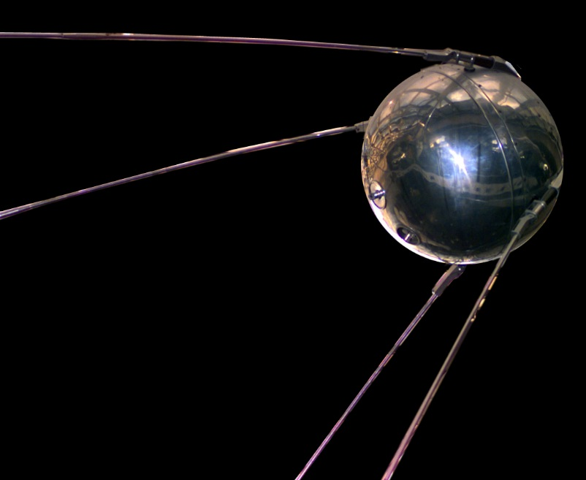
Sputnik

Slide 6
This is the distance at which spacecraft orbiting the Earth complete one orbit every 24 hours. GPS, television and communication satellites are all examples of spacecraft orbiting at this distance.
This is important because this is the same speed as the rotation of the Earth meaning that they effectively remain above a fixed point on the Earth.
What things might you see on any street which make use of this distance and which direction do all of these things point?
22,256 miles
Tennis ball scale = 80 cm

Slide 7
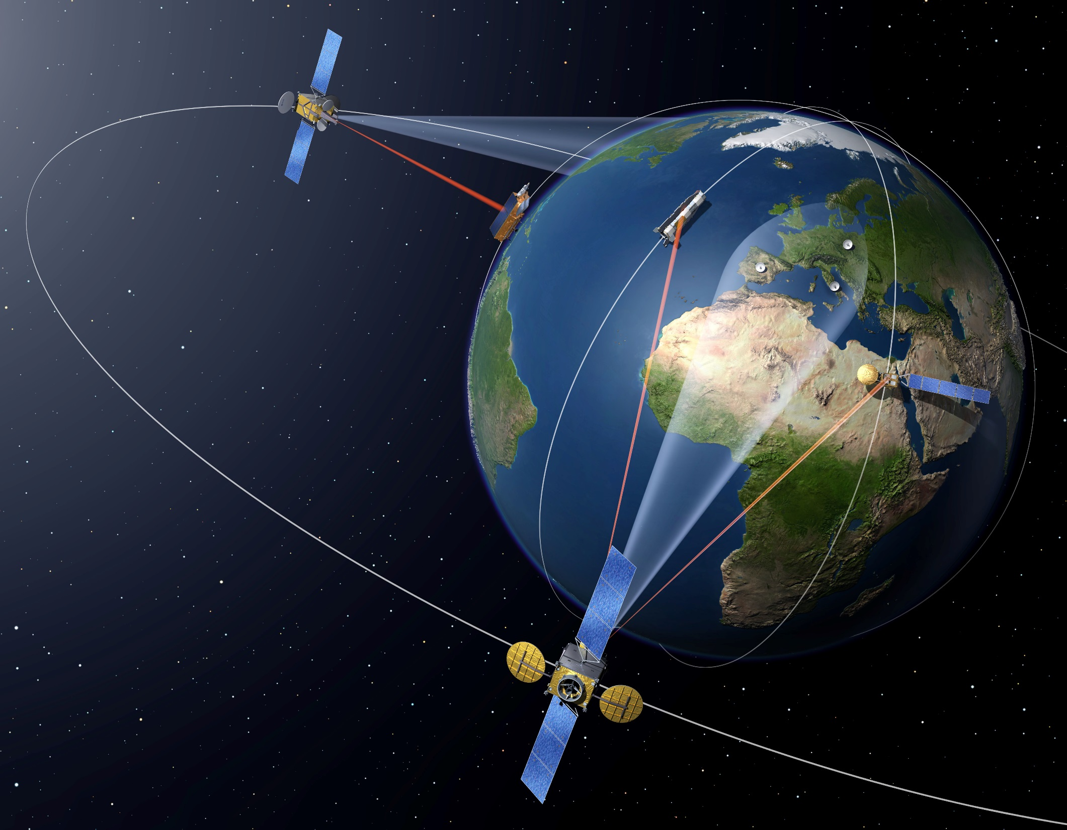
Geostationary Orbit

Slide 8
This astronomical body is Earth’s only natural satellite. Without this natural satellite life on Earth would be very different indeed as it effects the tides and protects us from meteorites, amongst many other things.
Whilst many robotic spacecraft have explored this satellite, only twelve humans - all American men - have been to this body, all between the years of 1969-1972.
What might it be like to explore this place and what things would we need to be careful of in order to survive here?
240,000 miles
Tennis ball scale = 8.62 metres

Slide 9
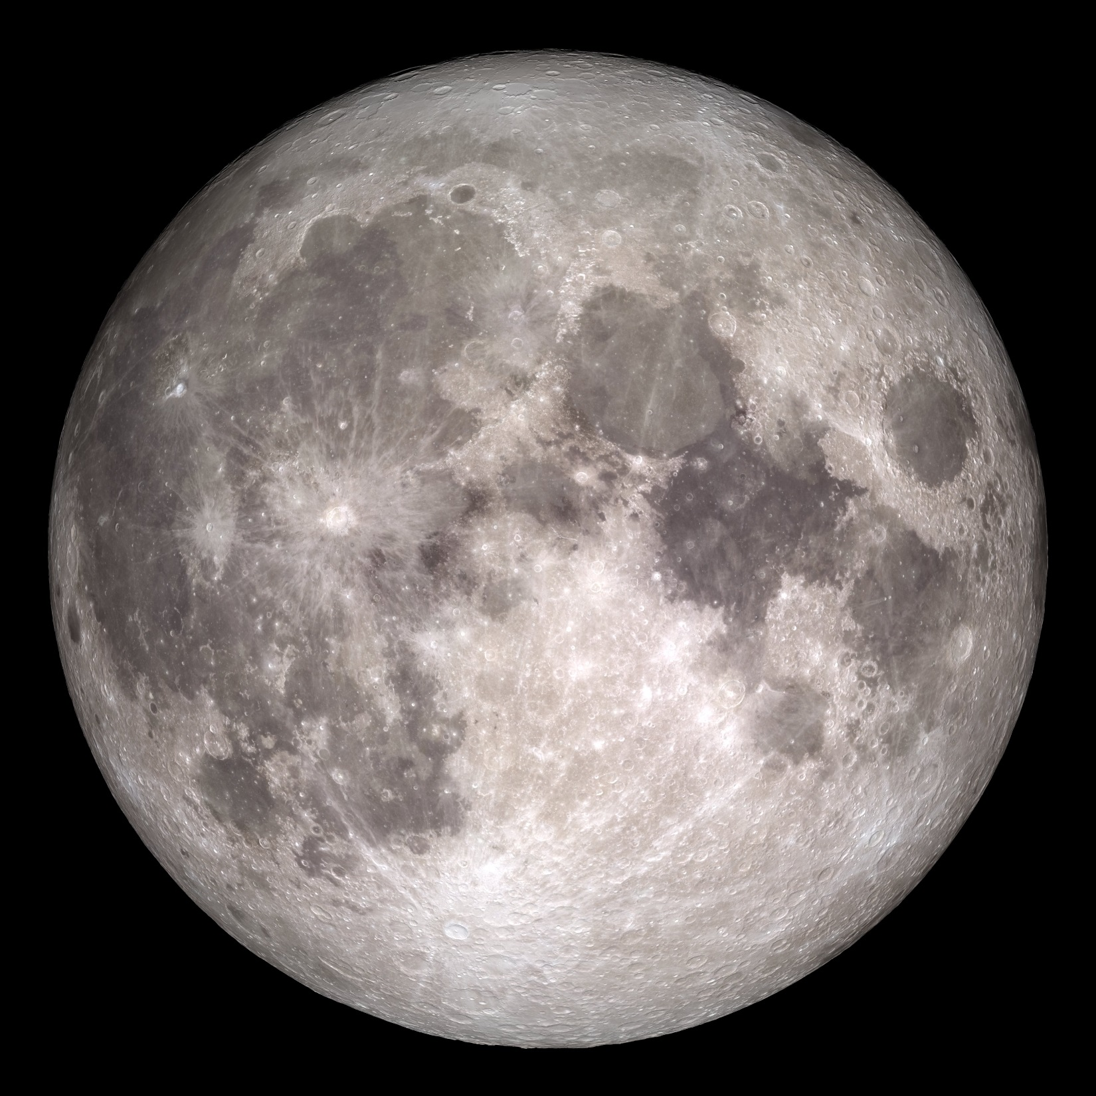
The Moon

Slide 10
This planet is the most Earth-like of all others in our solar system. For this reason it is important to learn as much about, and from, this planet as possible. Lots of robots have explored this planet, both from above and on its surface, and one day humans may too visit this planet.
Usually this planet is the closest to Earth but sometimes another planet is closer.
What is the name of this other planet and can you explain why the distance between Earth and this planet varies a lot?
48,000,000 to 234,000,000 miles
Tennis ball scale = 1 to 5 miles

Slide 11
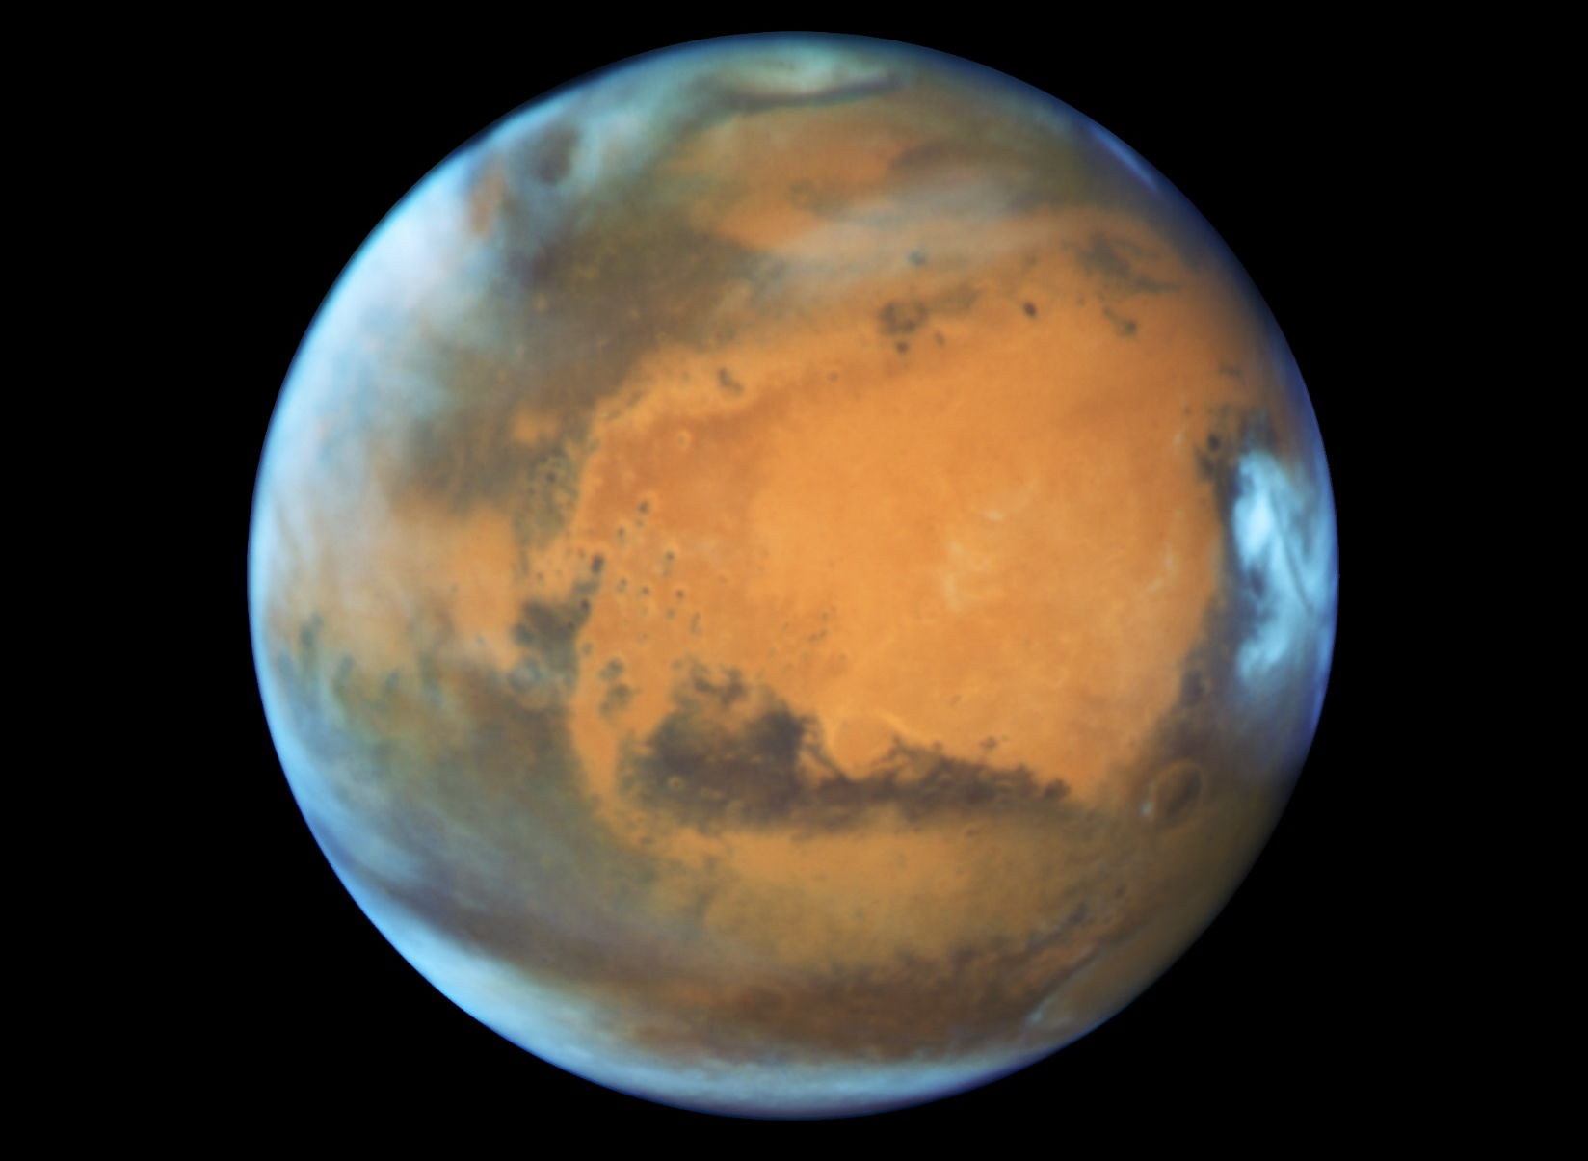
Mars

Slide 12
This is our star, the centre of our solar system and the body which all of the planets orbit. It is important to learn about our star as it is the reason for day and night, the seasons and the source of all energy for our planet.
This distance to our star was unknown until the 1761 Transit of Venus across the face of the Sun.
What do you think stars are made of?
Tennis ball scale
= 2 miles (3.3 km)
93,000,000 miles = 1AU (astronomical unit)

Slide 13
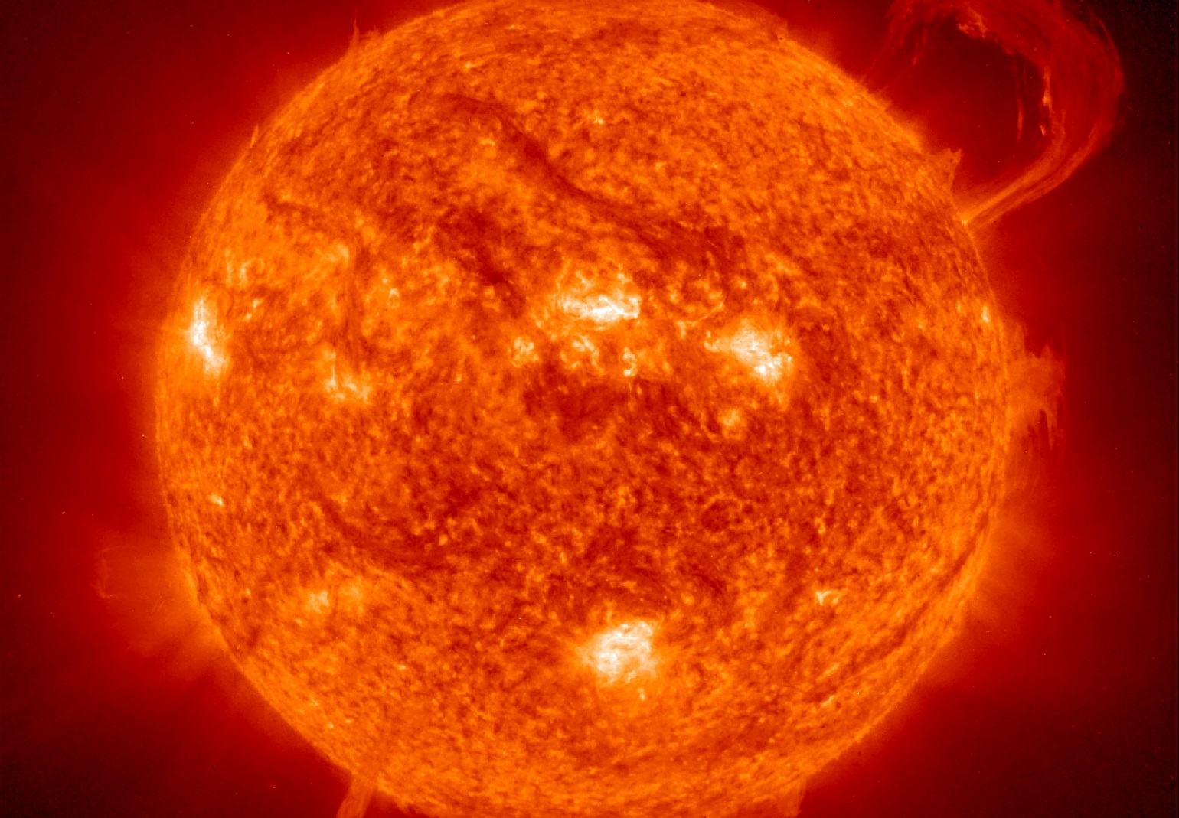
Our Sun

Slide 14
This pair of spacecraft were launched in 1977 and performed flybys of Jupiter, Saturn, Uranus and Neptune to reach interstellar space in 2012, having travelled further than anything else in history.
Both spacecraft carry a golden record with sounds and images of life on Earth, just in case the spacecraft ever reach life on another planet.
How likely do you think it is that life exists on another planet and how likely do you think we are to ever make contact?
Tennis ball scale = 282 miles = 454 km
(width of UK)
20,265,000,000 km ≈ 136 AU

Slide 15
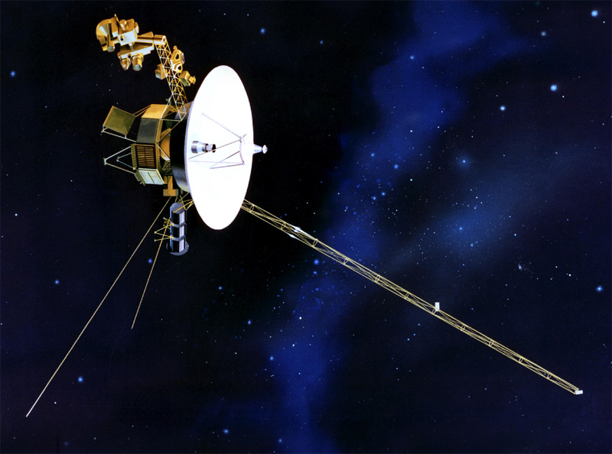
The Voyager Spacecraft

Slide 16
Beyond the solar system, this is the nearest star to Earth. Studying the stars is important to help us to understand how the universe was created and how stars and solar systems form.
This distance to this star is important because it is the smallest distance that light from any of the stars travels to reach us. It is also the shortest time in which light has travelled from any star to reach us on Earth.
How many stars do you think you can see at night and why might people in different places see different numbers if stars?
Tennis ball scale = 575,000 miles = 925,000 km
(to the Moon and back!)
4.367 light years

Slide 17
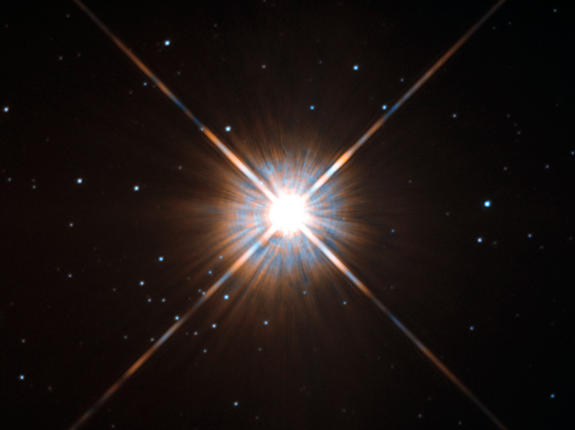
Alpha Centauri

Slide 18
Of the 100 billion galaxies in the universe, this is the closest to us. This galaxy is a spiral galaxy and contains around 1 trillion stars.
Learning about this galaxy is important because it is travelling towards our own and will one day collide with ours.
How many galaxies do you think there are in the whole universe and how do you think astronomers might be able to find an estimate of this?
Tennis ball scale = 36,000 AU
(that’s 36 times distance to the Sun)
2,537,000 light years

Slide 19
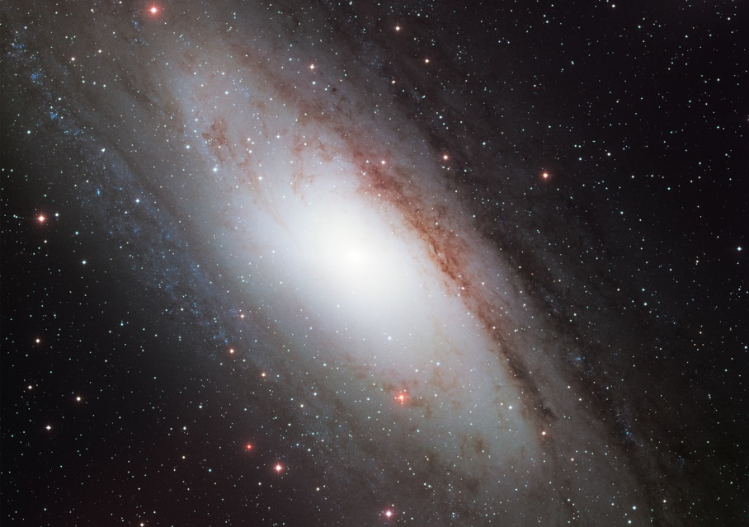
Andromeda Galaxy

Slide 20
This vehicle would not fly in space as it relies on the difference between air pressure above and below the wings to provide lift.
It is important to learn about this fundamental physical concept as has applications in a great many areas all over the world.
Name as many different types of this vehicle as you can.
35,000 feet ≈ 6.62 miles
Tennis ball scale = 0.2 mm

