Slide 1
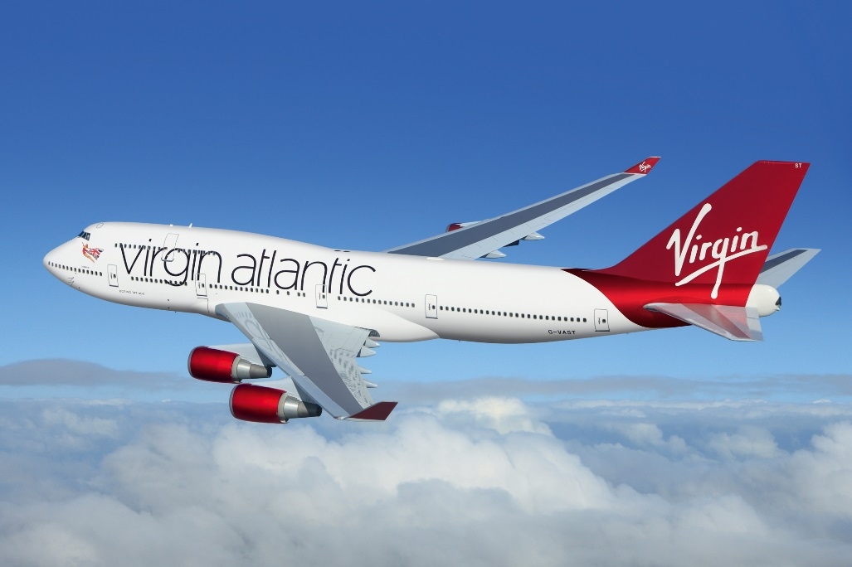
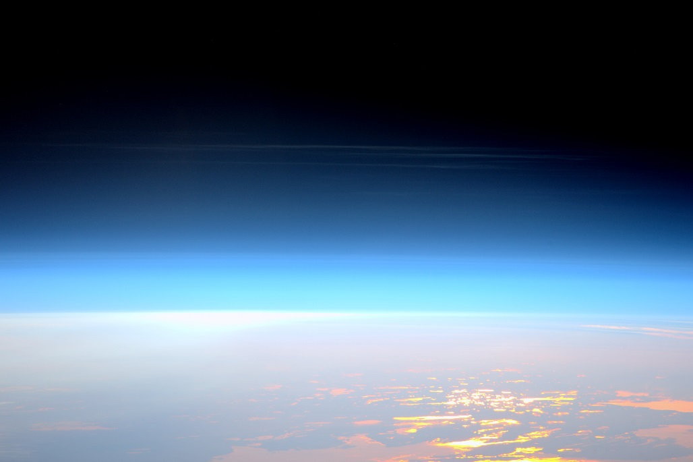
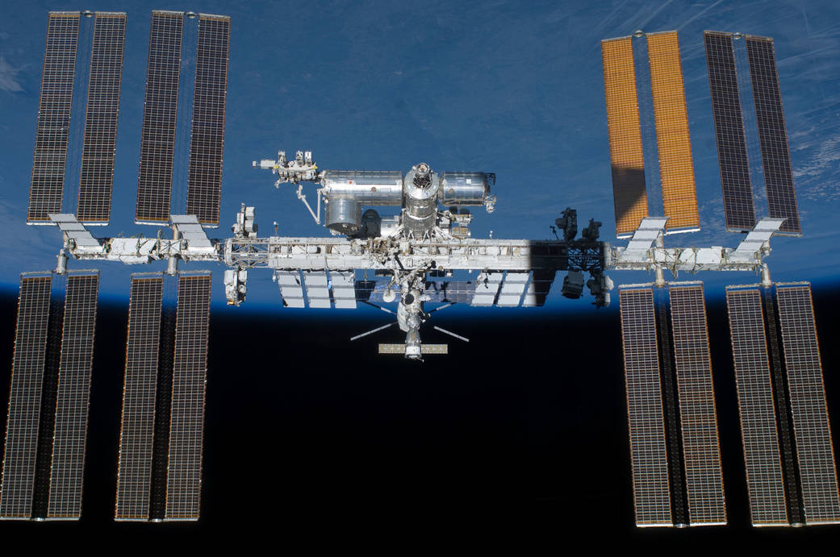
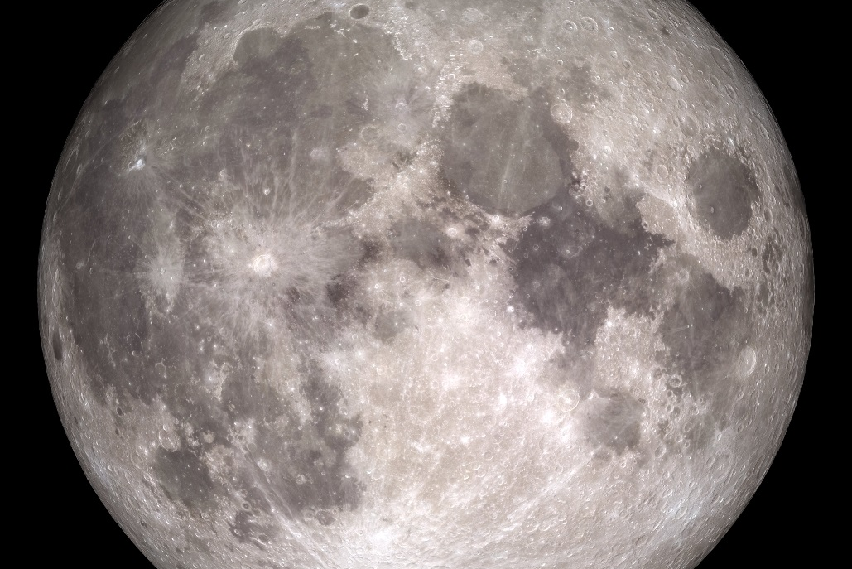
This distance is the height at which aeroplanes fly.
It is the most efficient altitude for aeroplanes to fly at.
Transatlantic Jet
There is no real beginning of space, instead the air just gets thinner as you go up.
There is no air in space so aeroplanes or helicopters cannot go there.
Official Limit of Space
This distance is known as low Earth orbit and is the distance at which the space station orbits the Earth.
This spacecraft is the size of two football pitches and has been permanently manned since 2000.
International Space Station
This is the distance to Earth’s only natural satellite.
Only 24 humans have travelled this far into space, all between the years of 1969-1972. Twelve of them walked on here.
The Moon

Slide 2
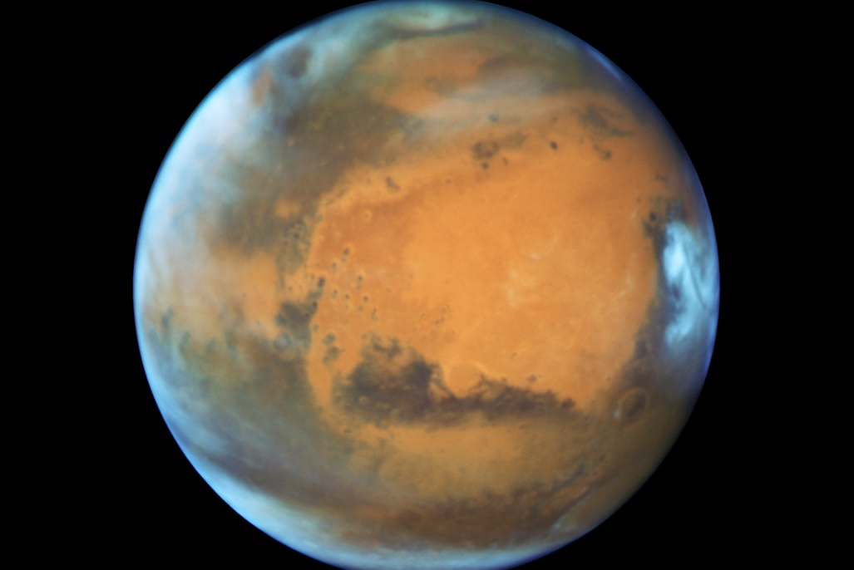
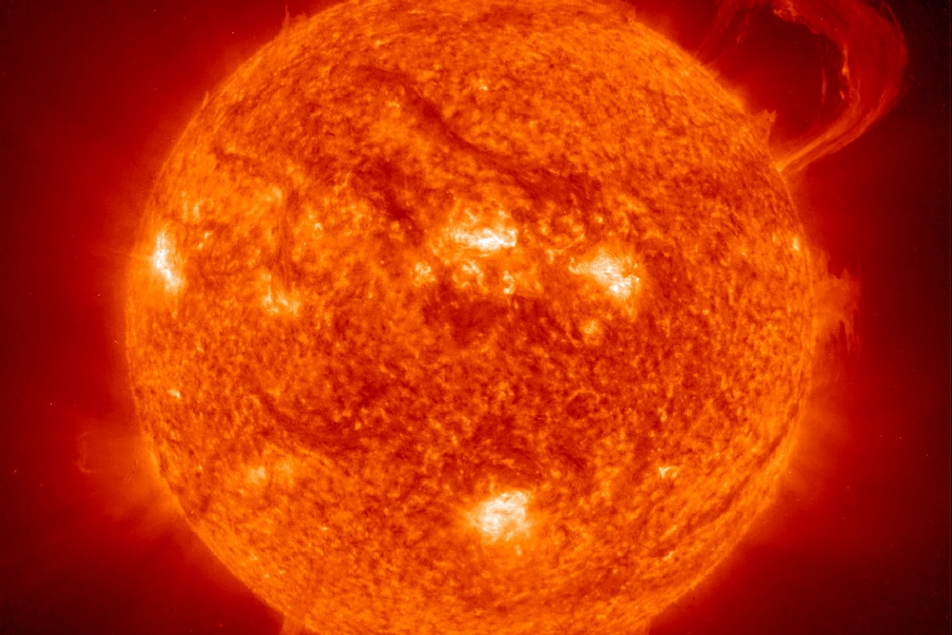
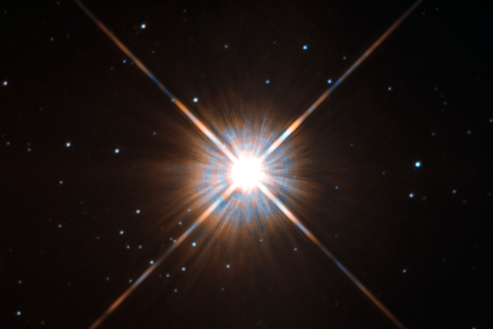
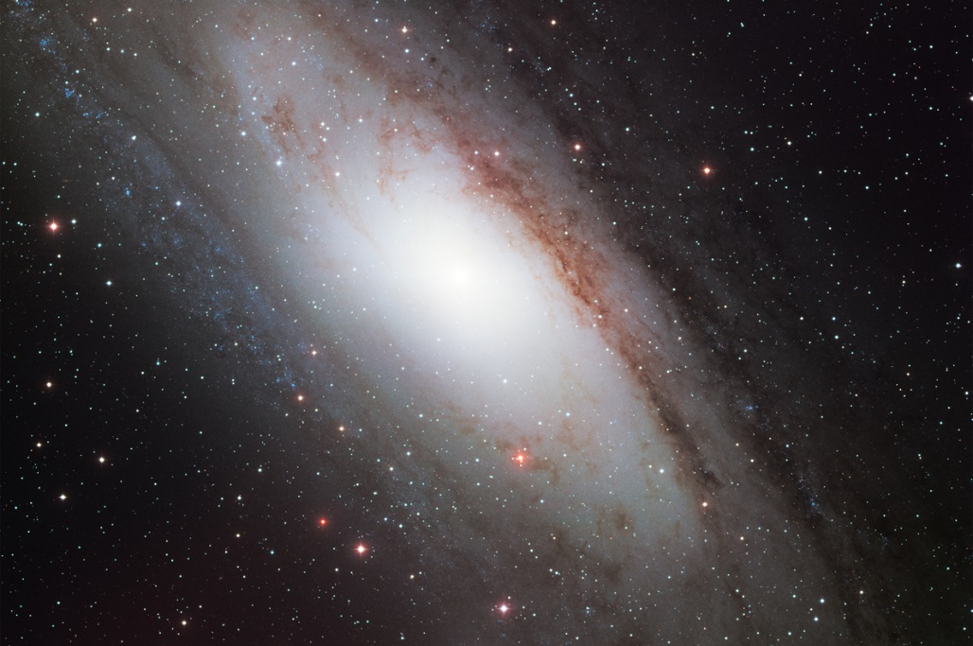
These are the closest and furthest distances between this planet and the Earth.
This distance varies because the Earth and this planet orbit our Sun at different speeds so, are sometimes closer together and sometimes further apart.
Mars
This is the distance to our Sun.
This distance was unknown until Venus passed across the face of the Sun in 1761.
Our Sun
Beyond the solar system, this is the nearest star to Earth.
This distance is important because it is the smallest distance, and time, that light from any star takes to reach us.
Alpha Centauri
This is the closest galaxy to ours and this distance is important because this galaxy is travelling towards our own and will one day collide with ours.
This galaxy is a spiral galaxy and contains 1 trillion stars.
1 trillion = 1,000,000,000,000
Andromeda Galaxy

Slide 3
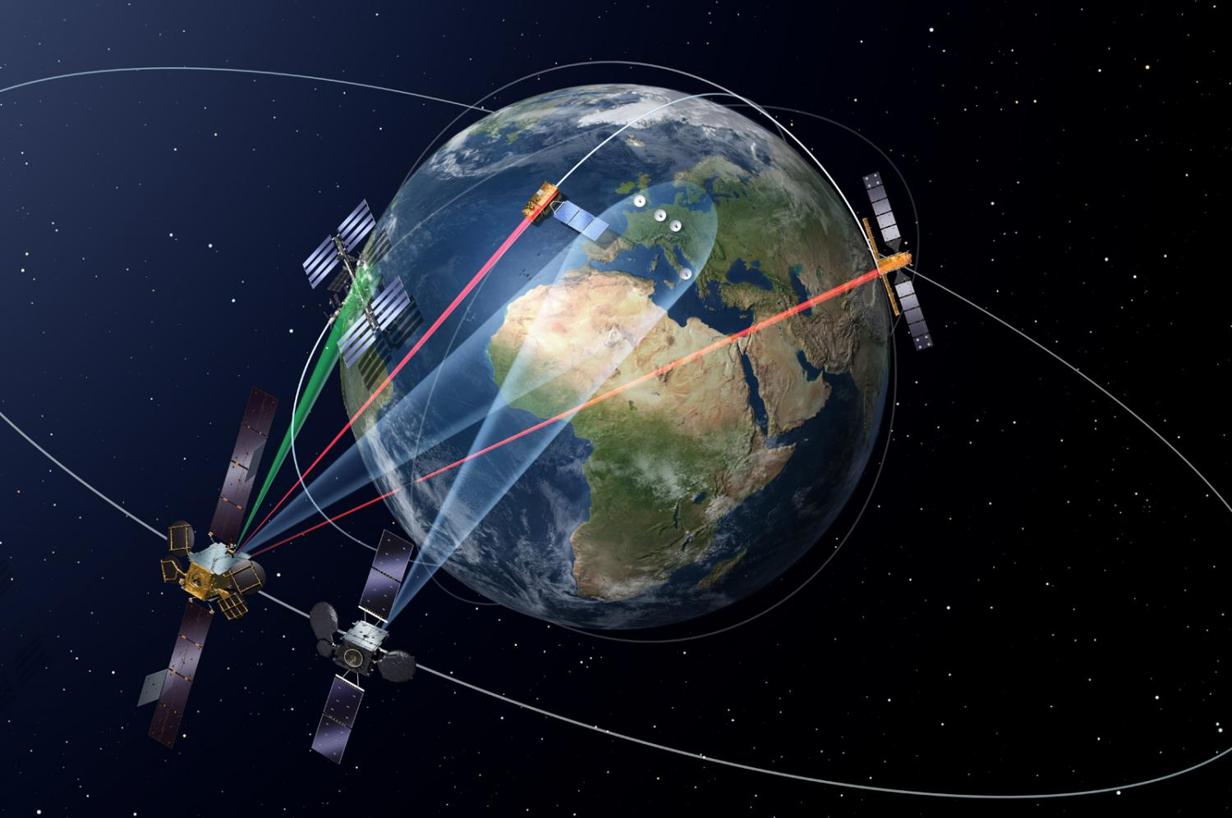
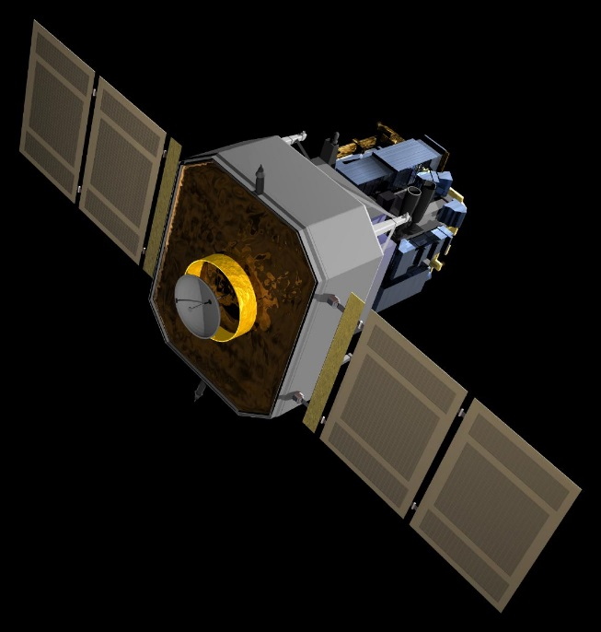
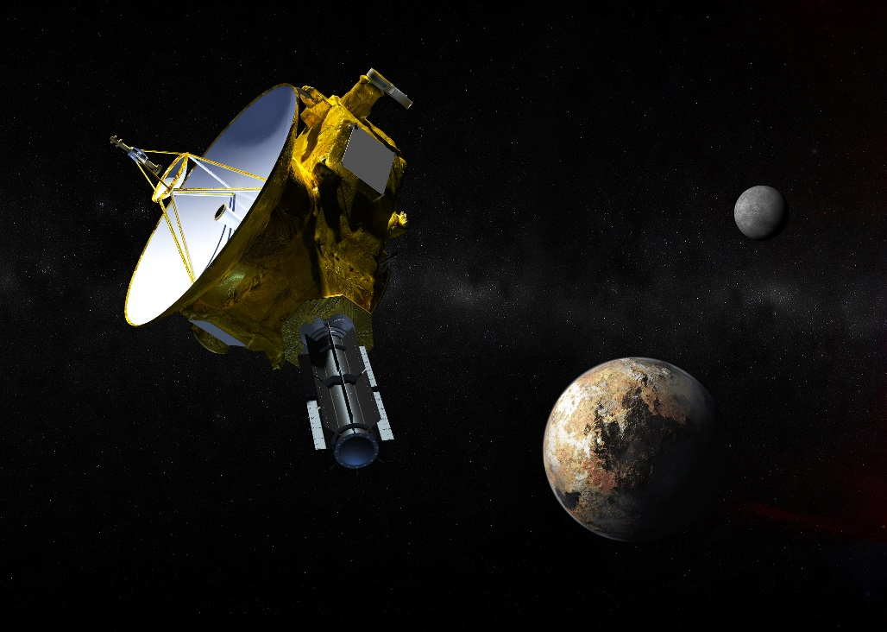
At this distance, satellites take 24 hours to orbit the Earth once.
This is where GPS, television and communication satellites are.
Geostationary Orbit
This is the distance to one of four special points around the Earth where satellites can be put and stay is place, relative to the Eartha and the Moon.
This satellite helps scientists to learn about how our Sun works and how its affects on our Earth.
SOHO Solar Observatory
This distance is how far the furthest spacecraft ever has reached.
This spacecraft is beyond the planet Pluto and near the edge of our solar system.
New Horizons Spacecraft

Slide 4
7 miles
48,000,000 to 234,000,000 miles
50 miles
93,000,000 miles
= 1 astronomical unit
250 miles
4 light years
1 light second = 186,000 miles
240,000 miles
2,500,000 light years
1 light second = 186,000 miles

Slide 5
20,000 miles
932,000 miles
40 astronomical units

