Slide 1
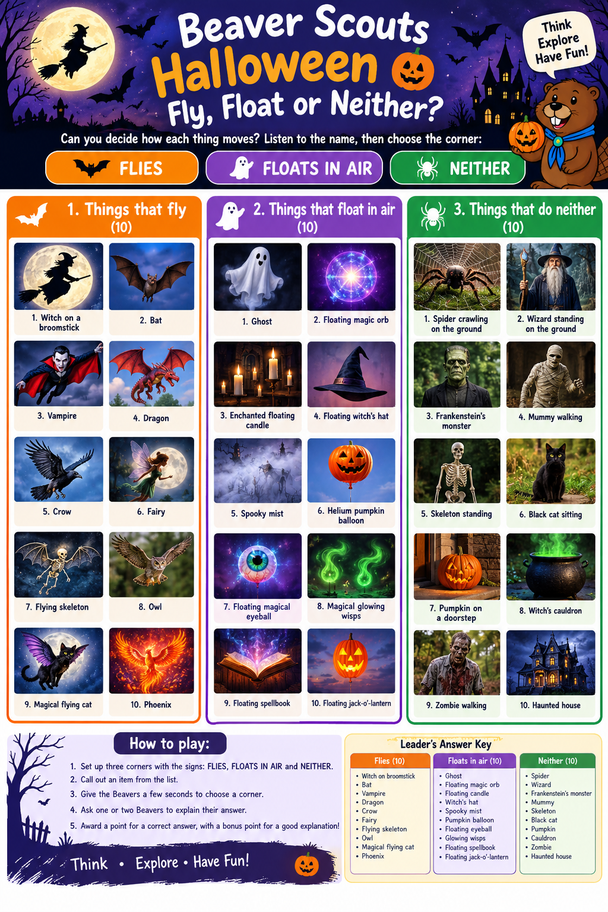

Slide 2
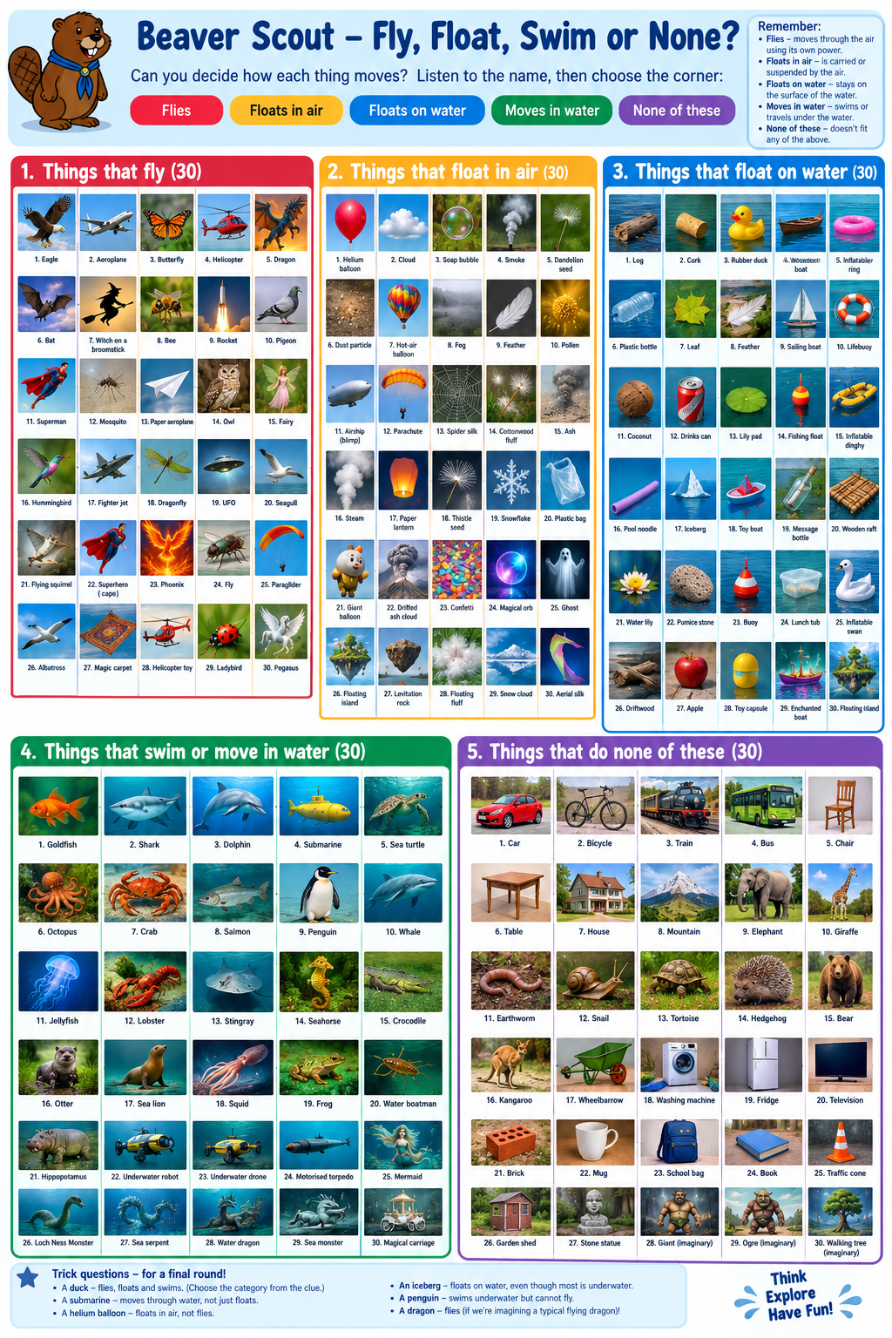

Slide 3
How to play
Label five corners of the room: FLIES, FLOATS IN AIR, FLOATS ON WATER, MOVES IN WATER, and NONE.
Read an item aloud. Give Beavers five seconds to choose a corner.
Ask a few Beavers to explain their choice. Award a point for a correct answer and a bonus point for a good explanation.
For the main rounds, use the intended answer below. Save the trick questions for a multiple-answer final round.
Category definitions
Flies: Actively moves through the air in a controlled manner, e.g. a bird or aeroplane.
Floats in air: Is suspended or carried by air, but not controlled, e.g. a helium balloon or drifting seed.
Floats on water: Stays on the water's surface, either controlled or uncontrolled, e.g. a log or boat.
Moves in water: Actively swims or travels in or under water, e.g. a fish or submarine.
None: Does not fit any of the other categories in the intended scenario.

Slide 4
Created by humans, natural or imaginary?
 | Created by humans | Natural | Imaginary
Fly
Float
Neither
Fly, float or neither?

Slide 5
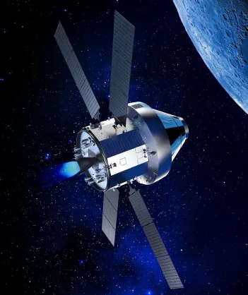
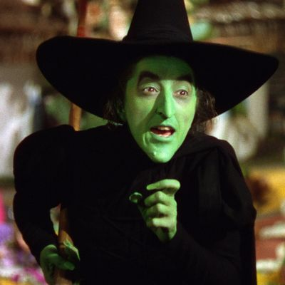
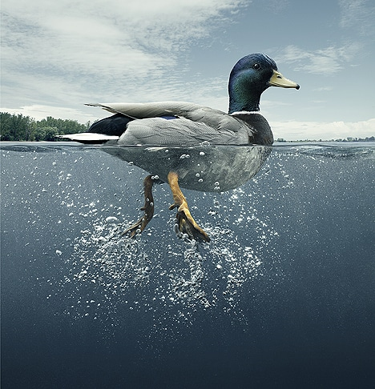
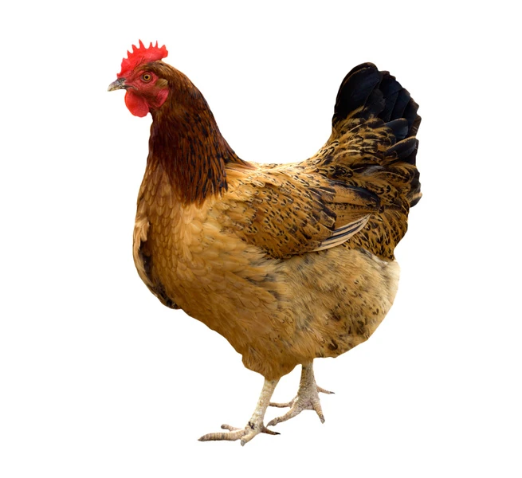
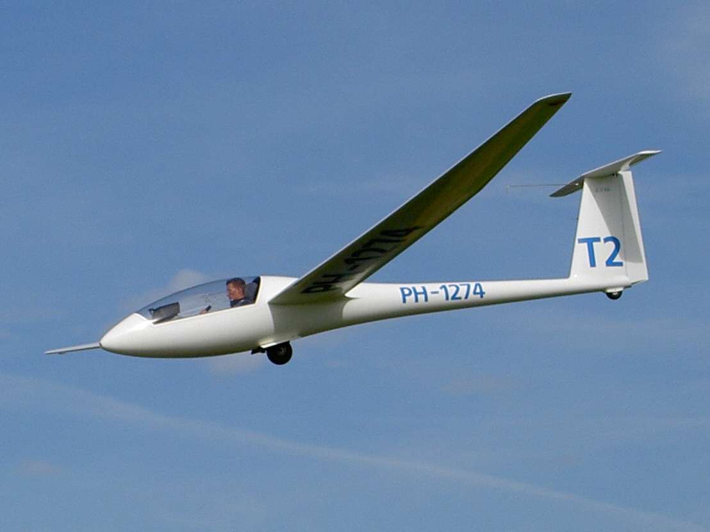
Spacecraft
Witch not on a broomstick
A duck
A chicken
Glider

Slide 6
Flies

Slide 7
Floats
in air

Slide 8
Floats
on water

Slide 9
Moves
in water

Slide 10
None

Slide 11
Aeroplane
Magic carpet
Bee
Bat
Bubble
Helium balloon
Hot air balloon
Witch
Witch on a broom
Wizard
Rocket
Spacecraft
Submarine
Superman
Spiderman
Dragon
Fairy
Cloud
Ghost
Feather
Boat
Paper
Log
Table
Parachute
Chicken
Duck
Penguin
Iceberg

