Slide 1
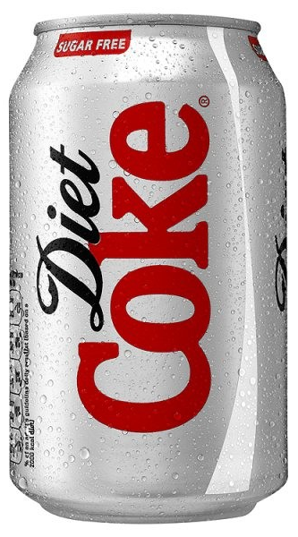
Which of these has the lowest centre of mass?
The can is full
A
B
C

Slide 2
Which of these has the lowest centre of mass?
The can is full
It’s a 330 ml can and the empty can weighs 15g
A
B
C

Slide 3
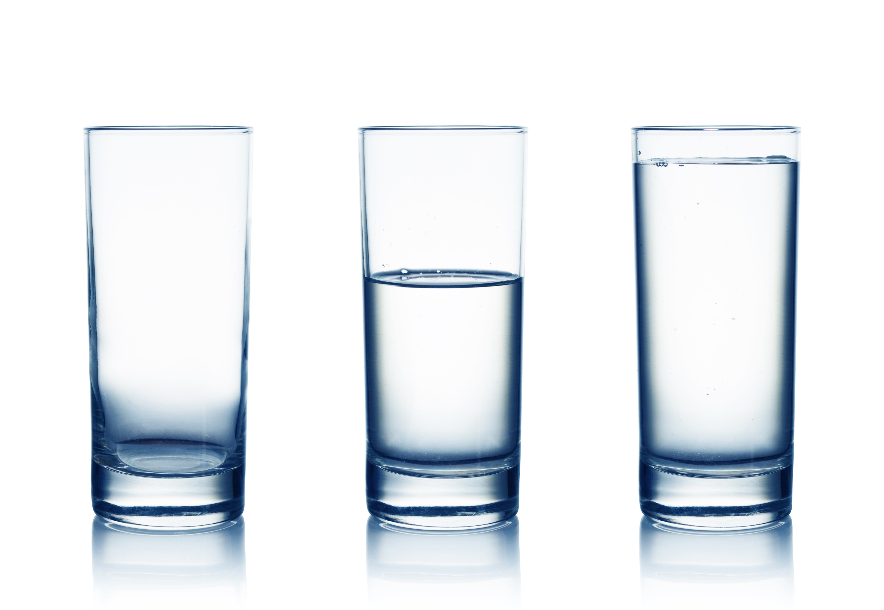
Which of these has the lowest centre of mass?
A
B
C

Slide 4
Centre of Mass
Design an experiment to confirm your prediction
Volume of water

Slide 5
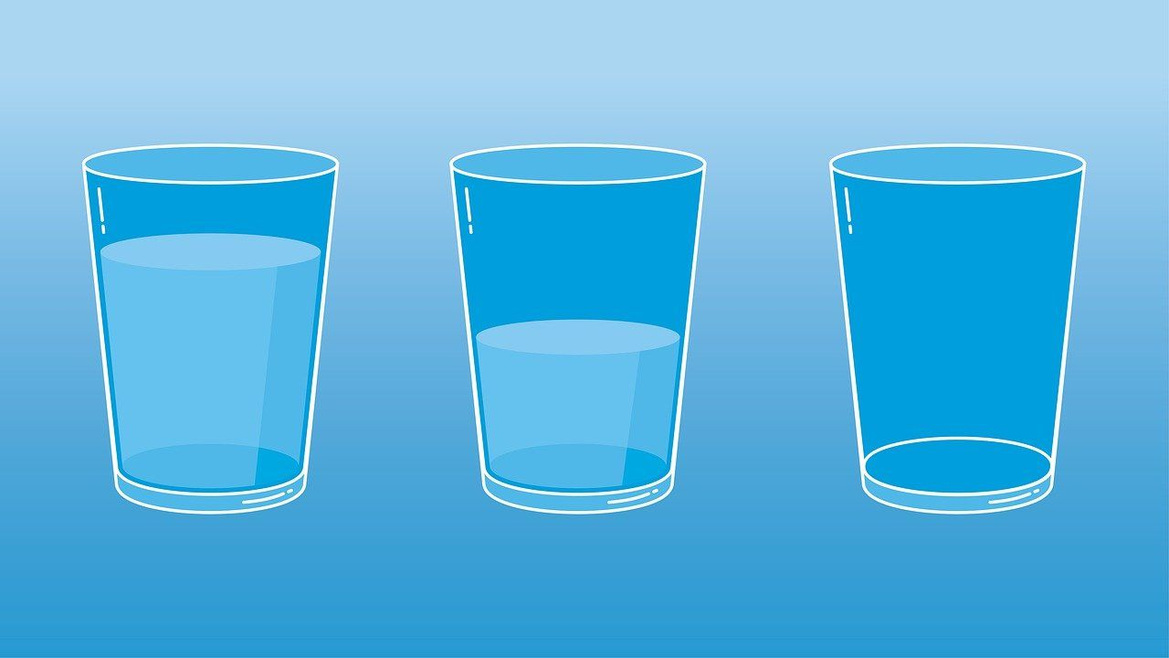
Which of these has the lowest centre of mass?
A
B
C

