Slide 1

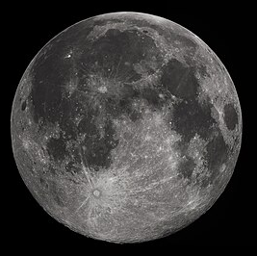

Slide 2

When ready, the lunar module will undock and separate from the command and service module.
At this point, the single spacecraft becomes two, with different callsigns to identify them.
One of the most dangerous parts of the mission is when the spacecraft returns to Earth and re-enters the atmosphere.
At T-0 the five big first stage Saturn V rocket engines light and the spacecraft-stack slowly lifts off. Once above the launch tower, control of the spacecraft switches from Kennedy Space Centre, Florida to Mission Control in Houston.
The launch vehicle is made up of three separate rocket-stages. Staging occurs twice during launch as one rocket-stage stops and another fires up.
When ready, the third rocket stage re-ignites to accelerate the spacecraft beyond Earth orbit and begin its four-day journey to the Moon.
On the way to the Moon, the crew command and service module separates, rotates 180$°$, and pulls the lunar module away from the now used up third stage rocket.
Following lunar module extraction, the spacecraft is placed into a slow continuous roll for the journey to the Moon so that all sides of the spacecraft are heated by the Sun equally.
Upon reaching the Moon, the service module engine fires to slow the spacecraft into lunar orbit.
After separating from the main spacecraft, the lunar module fires its descent engine to control its descent to the lunar surface.
As they reach the surface of the Moon, the astronauts fly the spacecraft manually before turning the descent engine off and dropping onto the lunar surface.
On leaving the Moon, the lower part of the lunar module becomes a launch pad for the upper part. The descent engine re-ignites to launch and reunite the moonwalkers with their crewmate back in lunar orbit.
The service propulsion system engine relights one last time to accelerate the spacecraft out of lunar orbit and onto the journey home.

Slide 3
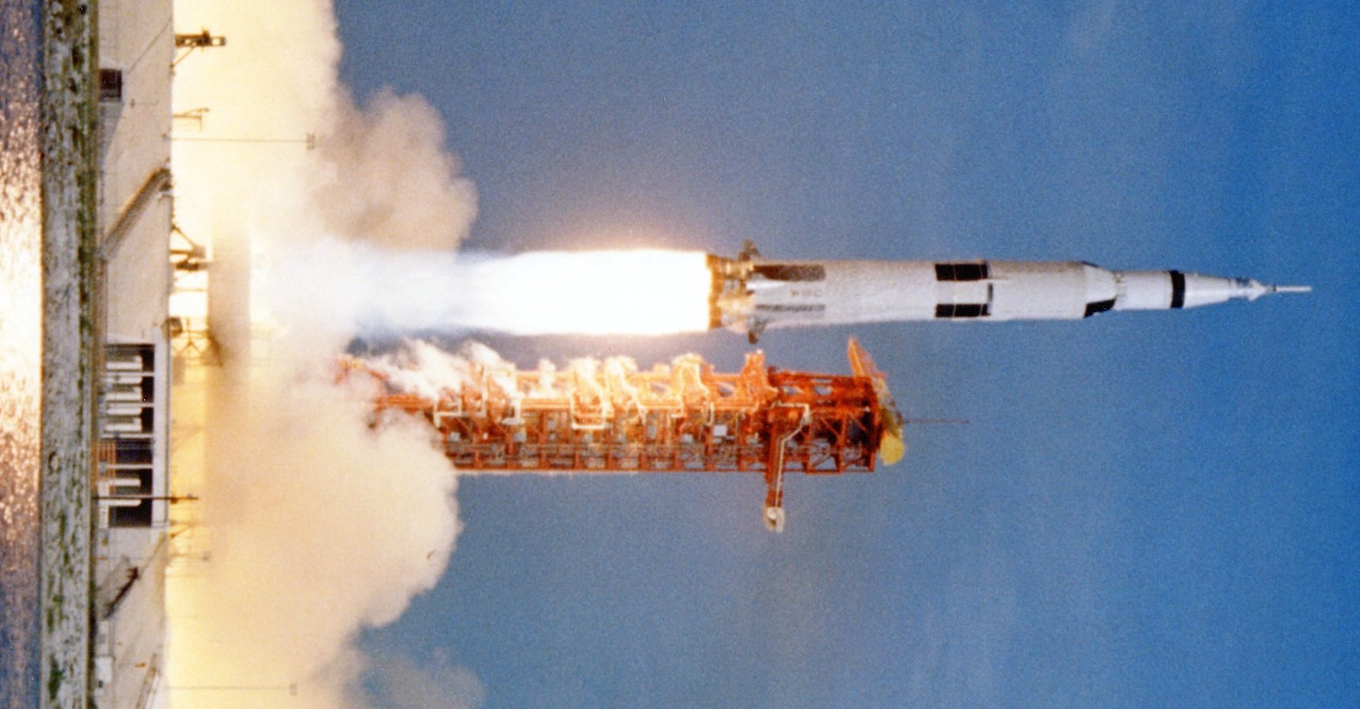
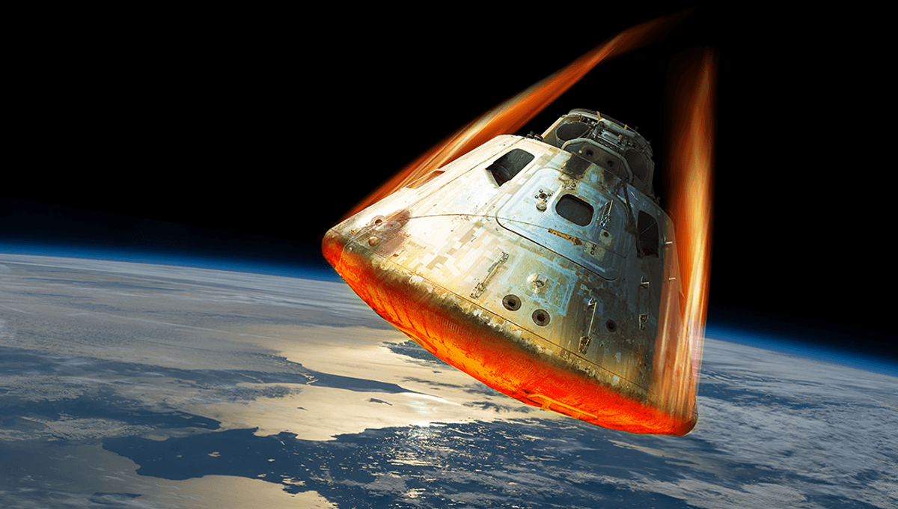
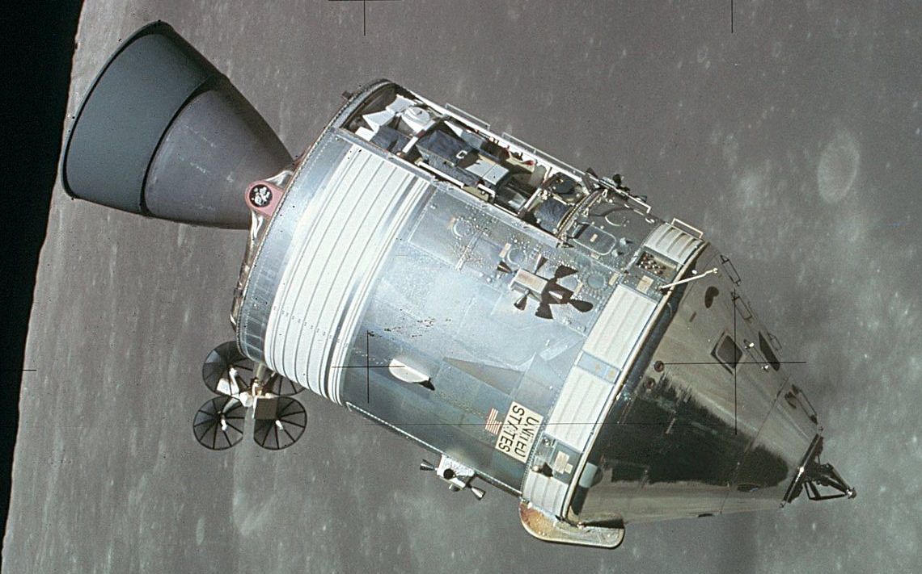
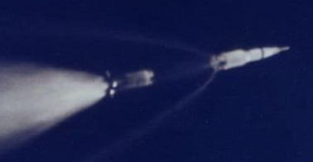
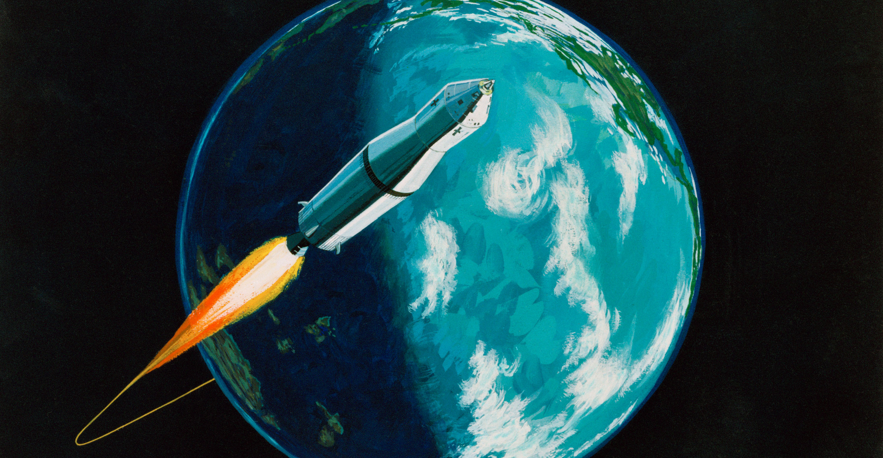
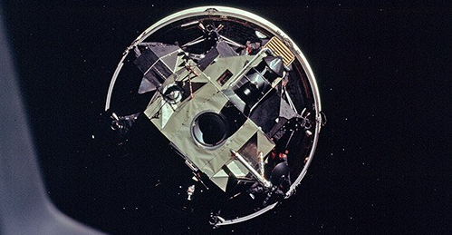
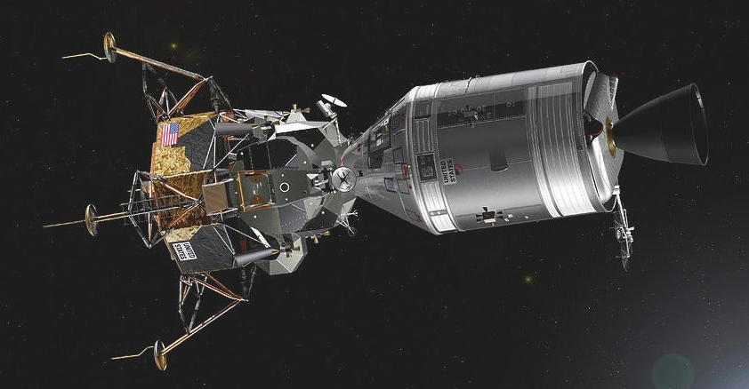
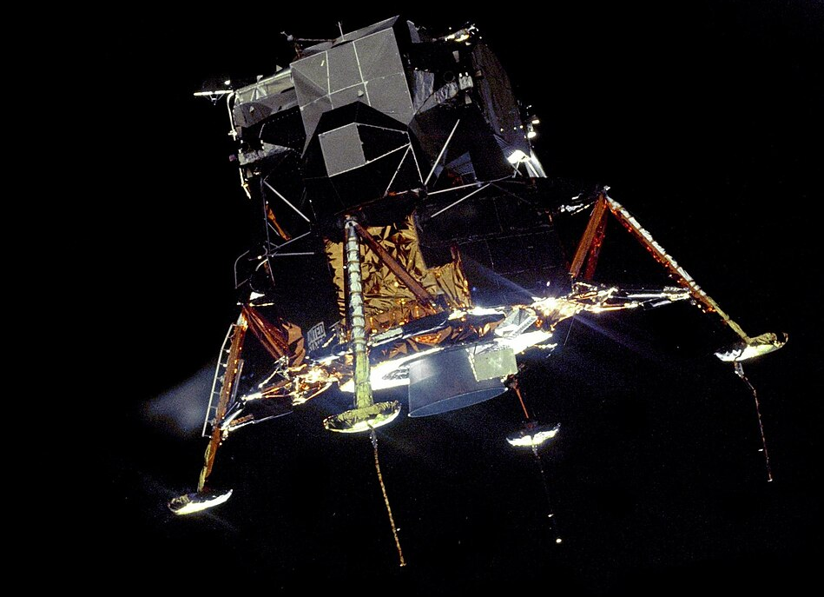
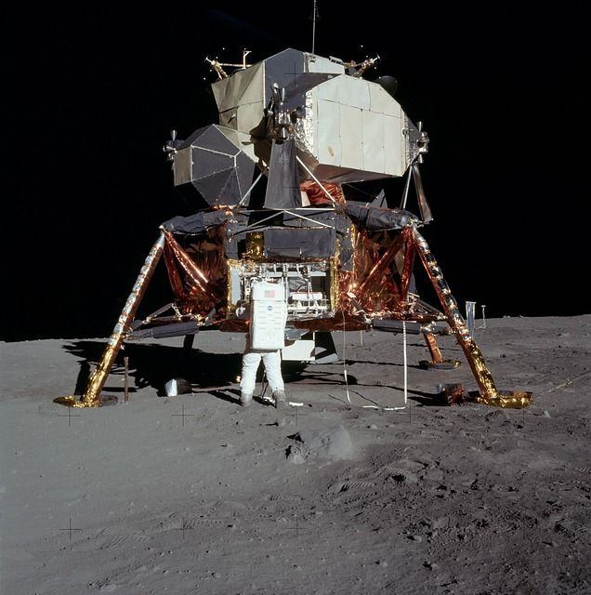
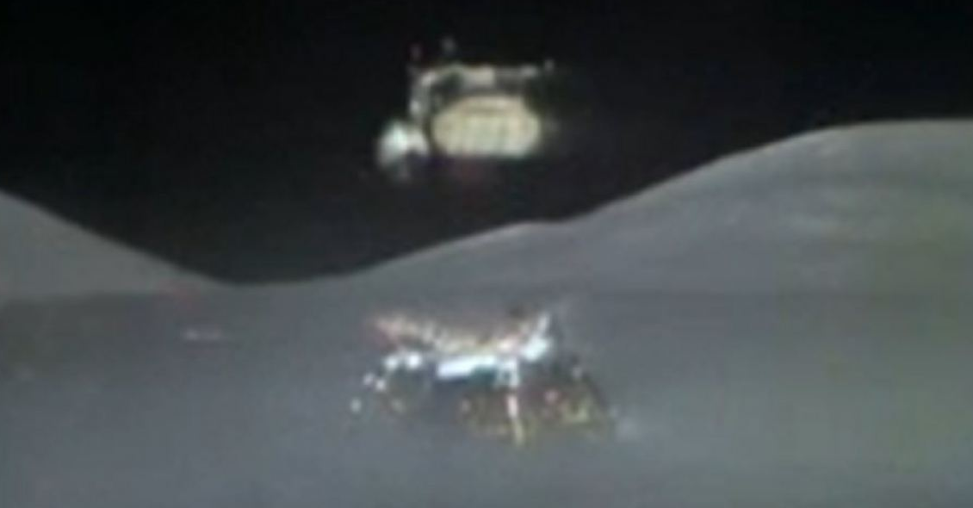
Re-entry & communication blackout
Launch
Undocking and Separation
Staging
Trans-lunar injection (TLI)
Transposition, Extraction & Docking
Passive thermal control (BBQ mode)
Lunar orbit insertion
Powered descent
Landing on the Moon
Lunar module ascent
Trans-Earth injection (TEI)

Slide 4
